Slide 1
Session six

Slide 2
Let’s look at the homework!

Slide 3
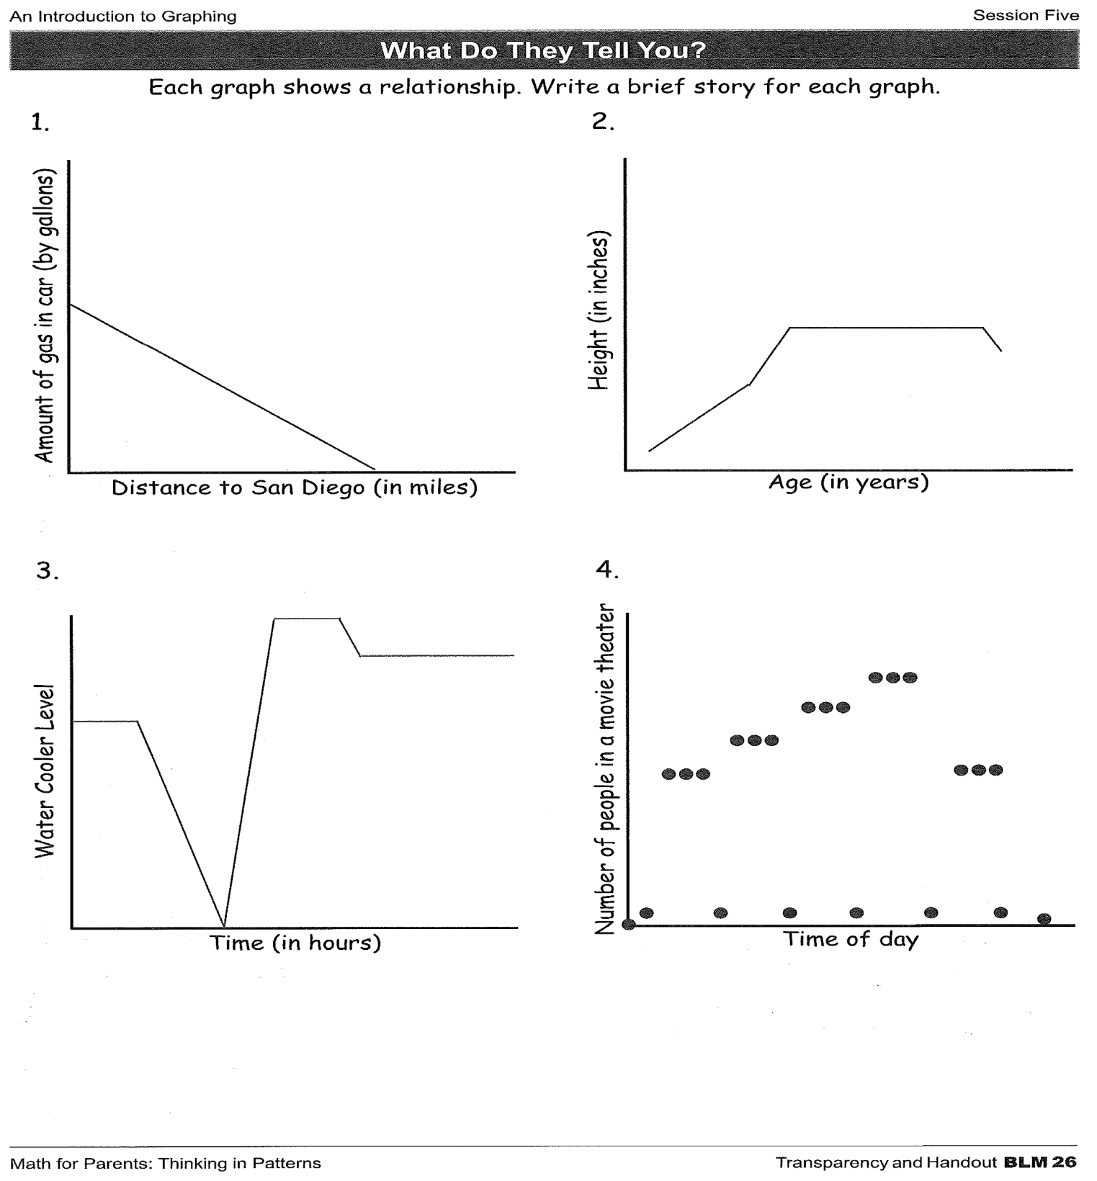

Slide 4
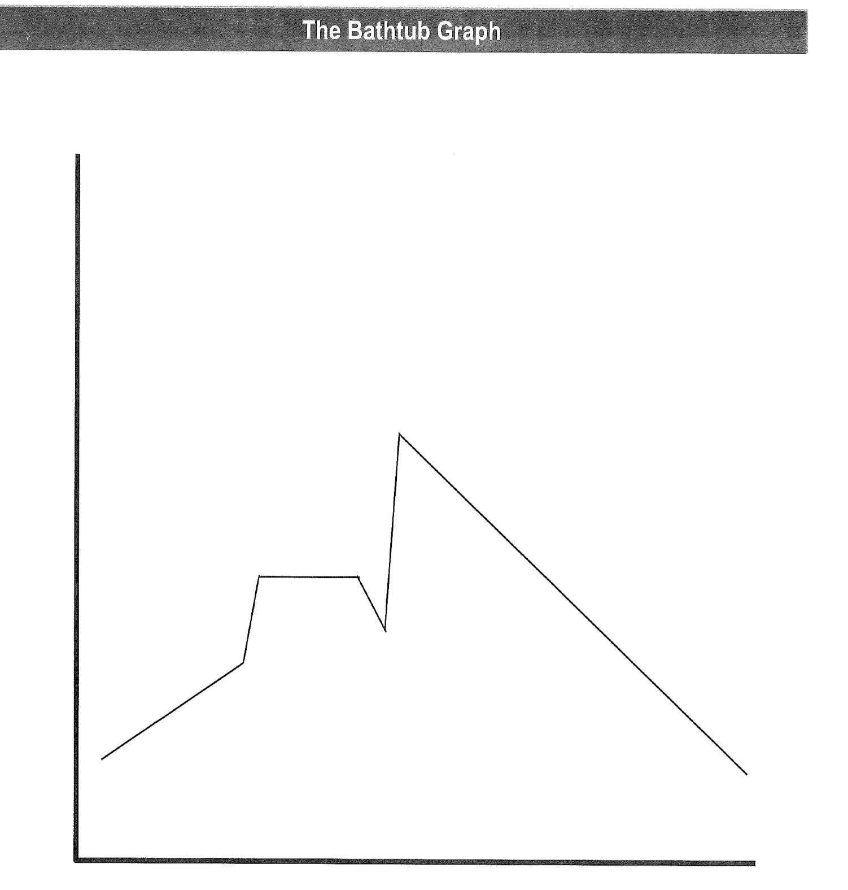

Slide 5
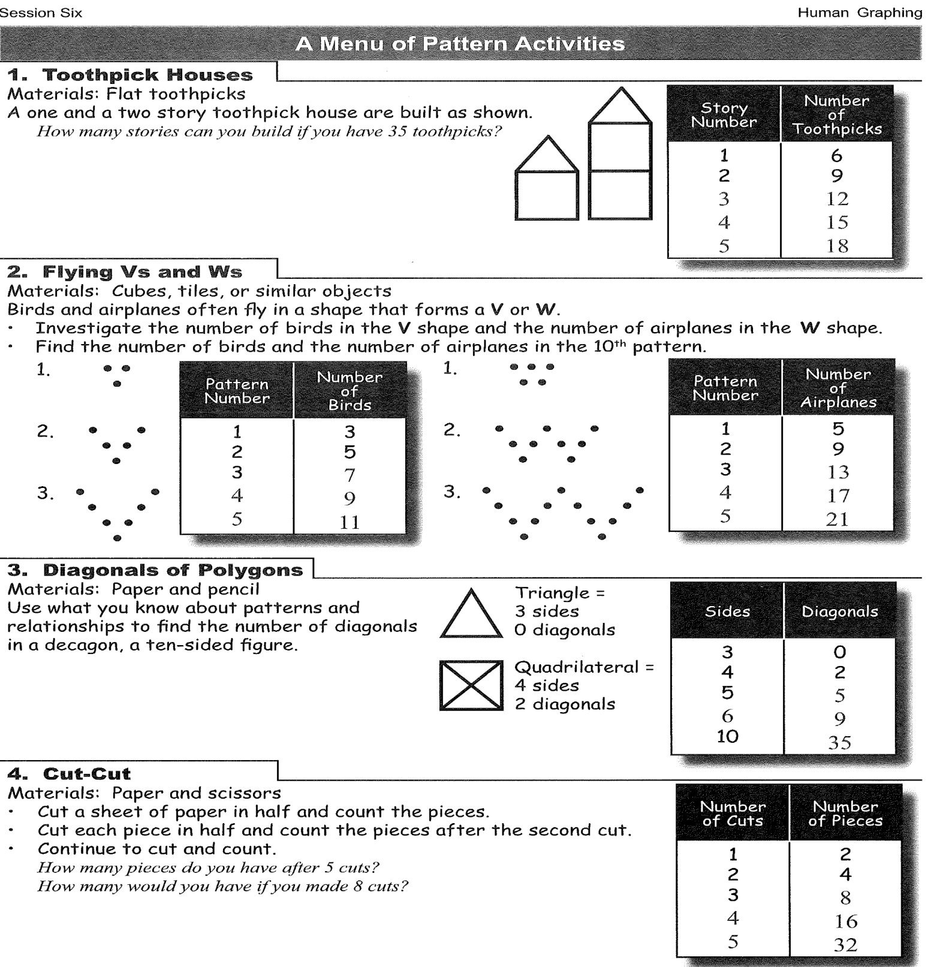

Slide 6
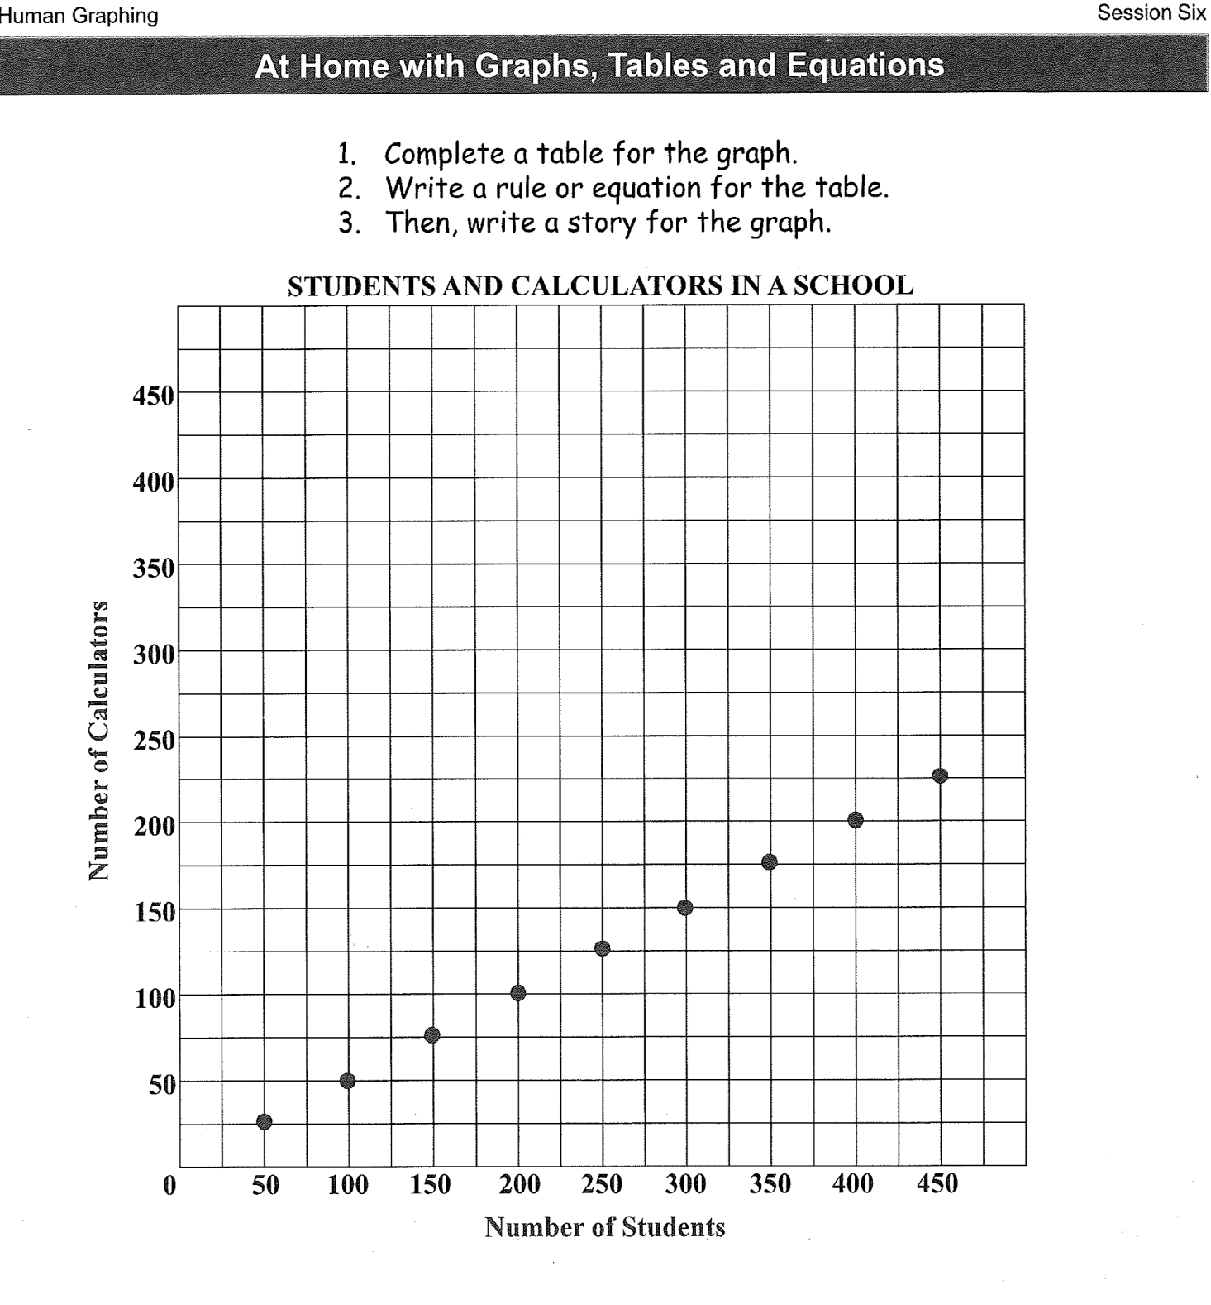

Slide 7
Thank you so much
See you all next week!

