Slide 1
My Giant
Proportional Reasoning

Slide 2
Agenda
Review of previous session’s homework
Welcome
Cognitive Guided Instruction
Purpose:
To experience problem solving through hands-on activities,
To become aware and appreciative of multiple strategies,
To become aware and appreciative of different learning styles.
Let’s Get Started!

Slide 3
Part 1:
Think about your items around your home. What item is a miniature or smaller model of an item?
Why is it smaller?
How much smaller is it?
How did you decide how much smaller it is?
The World’s Tallest Woman

Slide 4
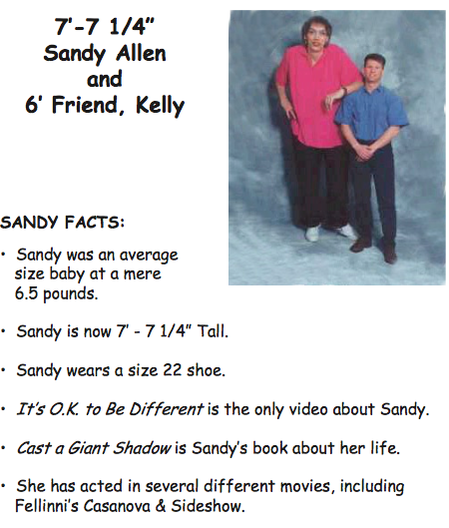
The World’s Tallest Woman – BLM 5

Slide 5
Footprints!!
Talk to your partner about an ESTIMATE for the height of the giant! Only use your heads!!
How are you thinking of doing this problem?
What have you done so far?
Where did you begin?
Are you stuck?
Make a poster and share your thoughts!

Slide 6
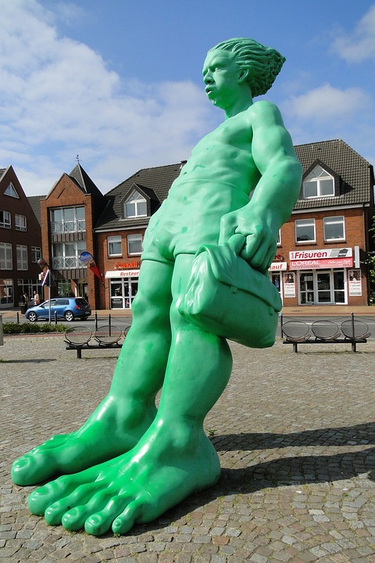
Present your Findings!!
Let’s have a look at what we discovered!!!
Museum Walk!!

Slide 7
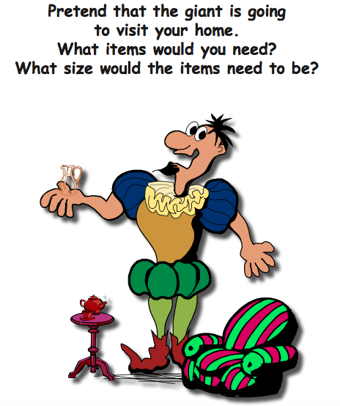
My Giant – BLM 6
How large would his toothbrush need to be?
What about the length of his bed?

Slide 8
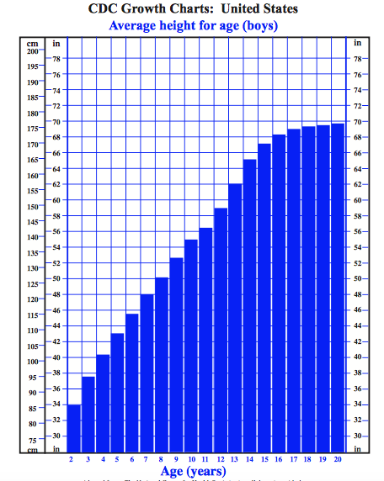
Growth Charts – BLM 7
What is this chart about?
What do the different parts of the chart tell you?
Discussion
What is the average height of a 10 year old?
At what age do you think our giant was 5 feet tall?
Talk about how you came up with this answer and what informed your decision.

Slide 9
The Giant’s New Crown – BLM 8
Design a crown that will fit the giant’s head!

Slide 10
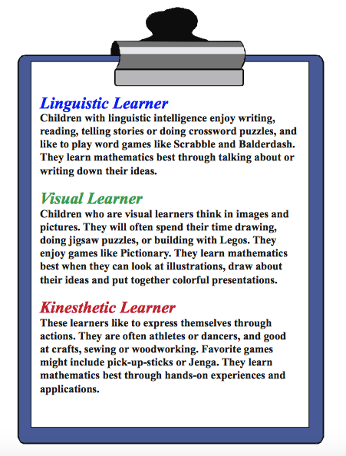
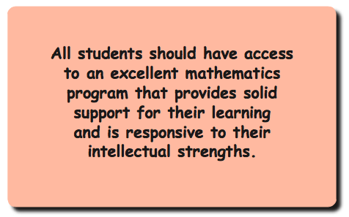
Equity in Education
Learning Styles
Accessibility Statement

