Slide 1
Session Three

Slide 2
Parental involvement: what do we know?
“The evidence is consistent, positive and convincing: families have a major influence on their children’s achievement. When schools, families, and community groups work together to support learning, children tend to do better in school, stay in school longer and like school more”
- Henderson and MAPP (2002).

Slide 3
Parenting techniques!

Slide 4
Let’s look at the homework!

Slide 5
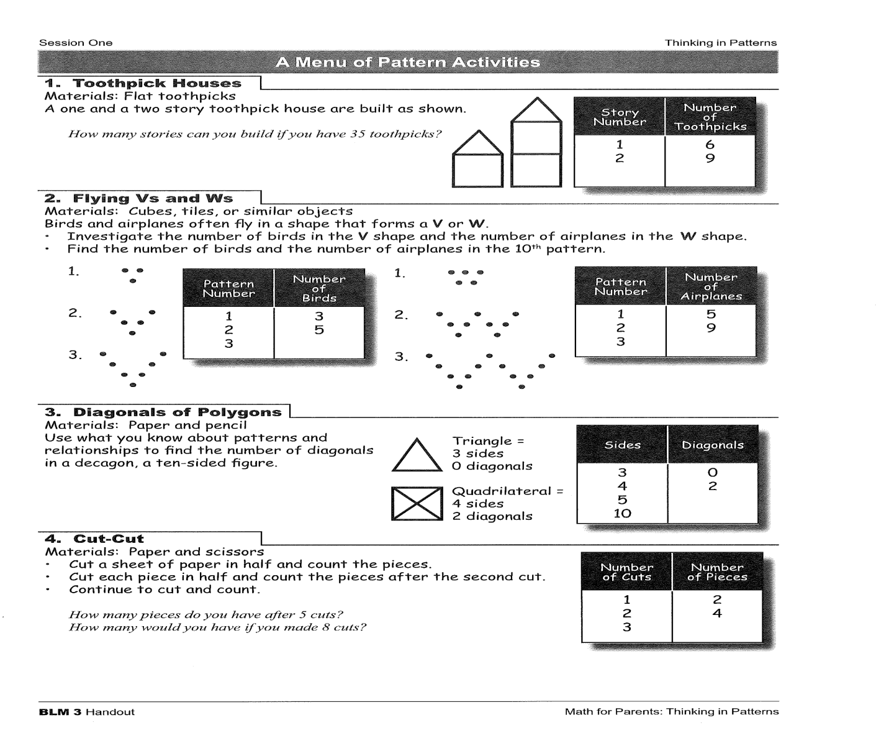

Slide 6
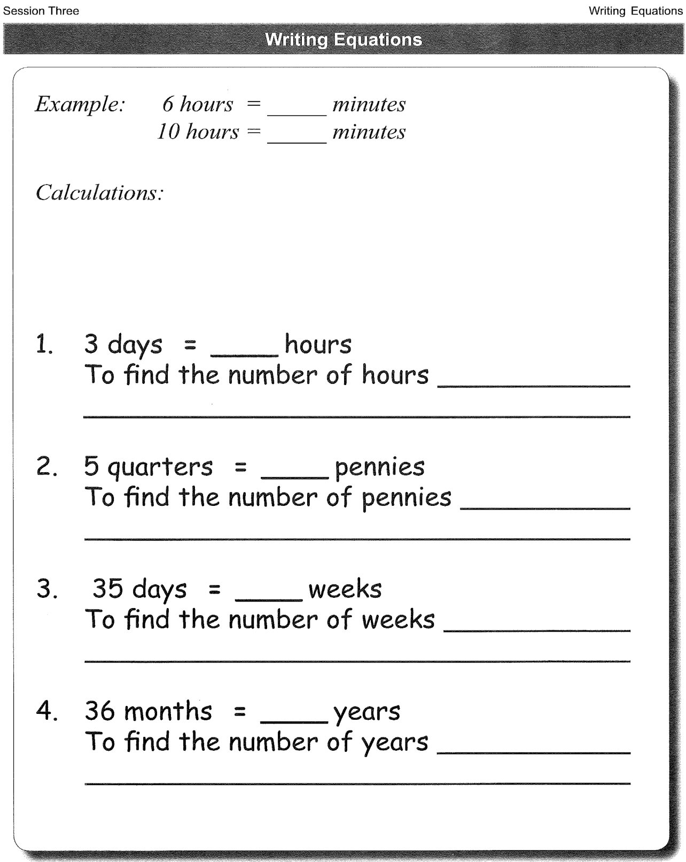

Slide 7
Algebraic expression: h x 60
Algebraic equation: m = h x 60

Slide 10
Share your ideas!

Slide 11
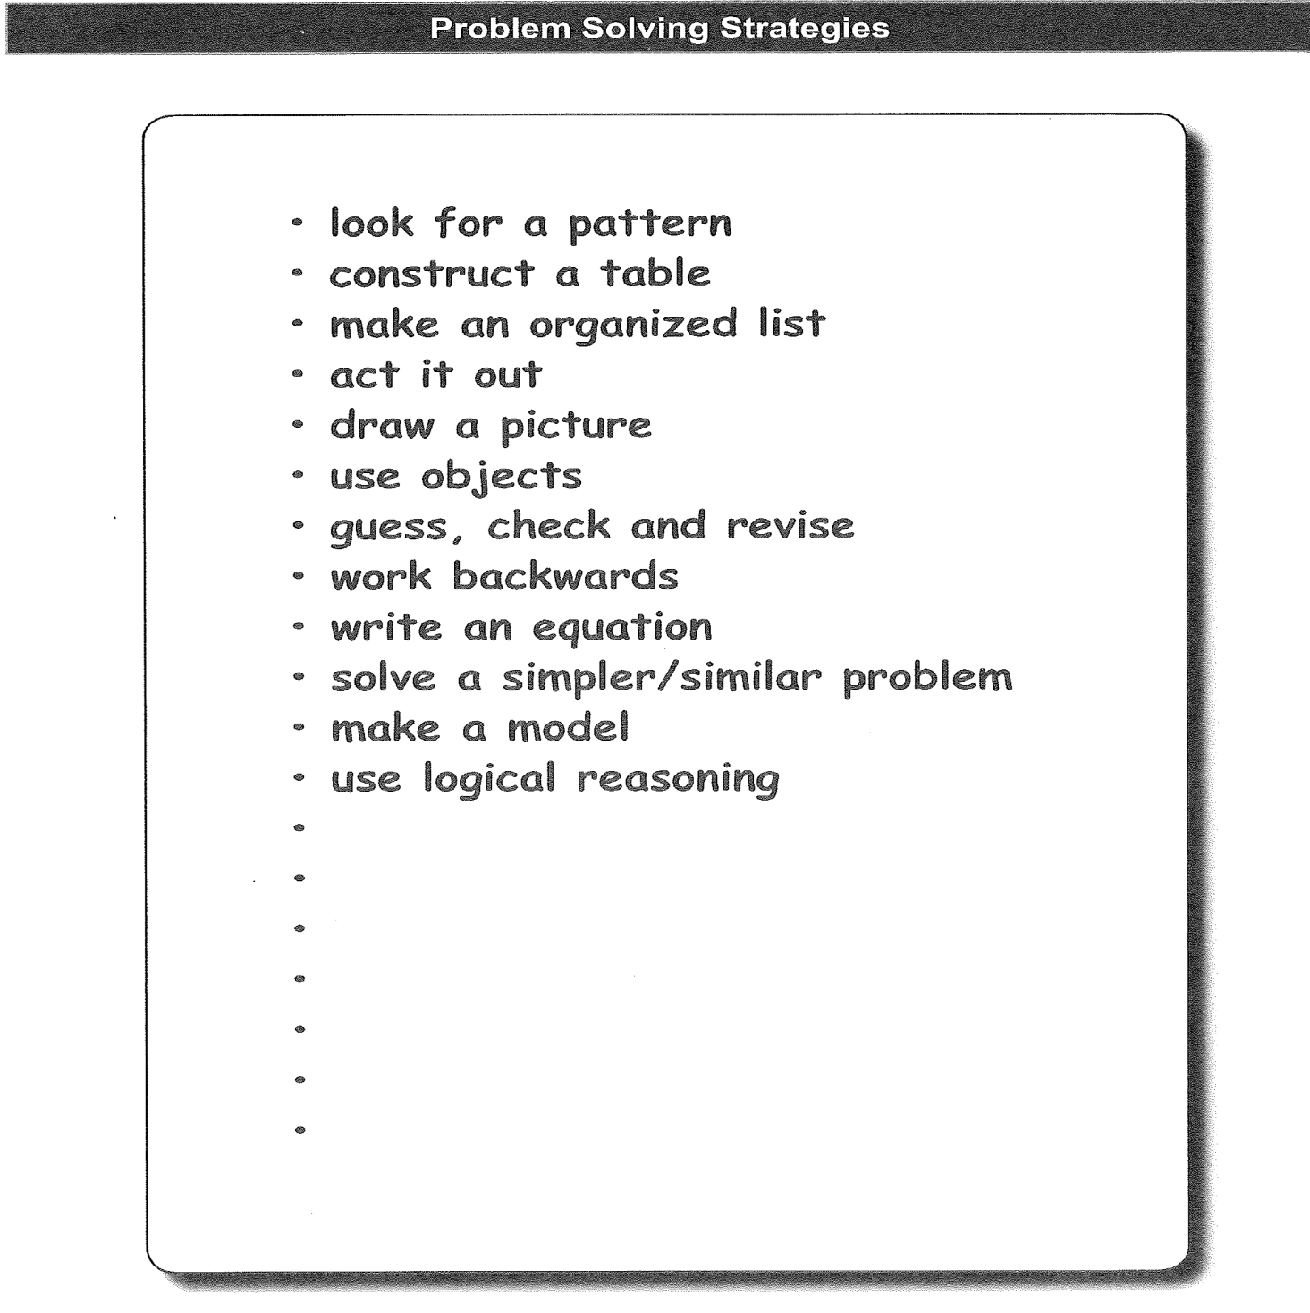

Slide 12
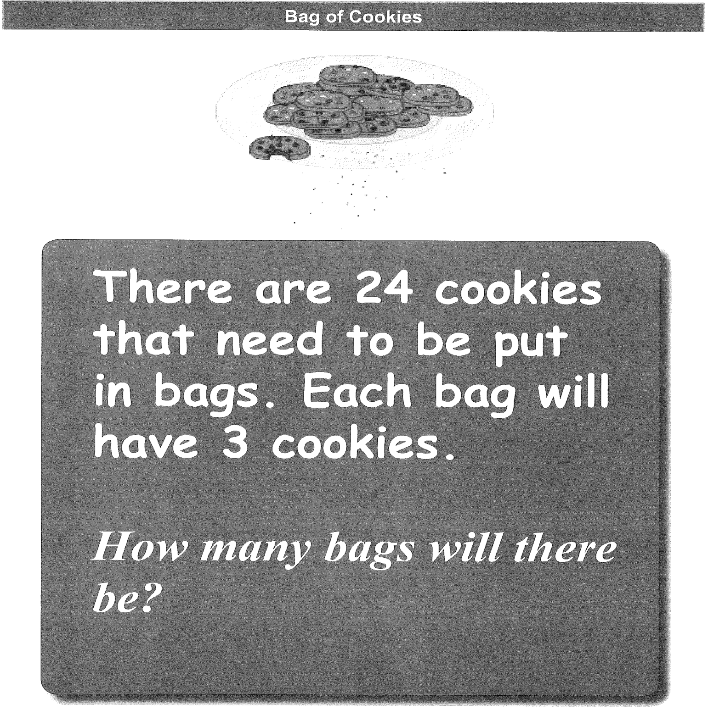

Slide 13
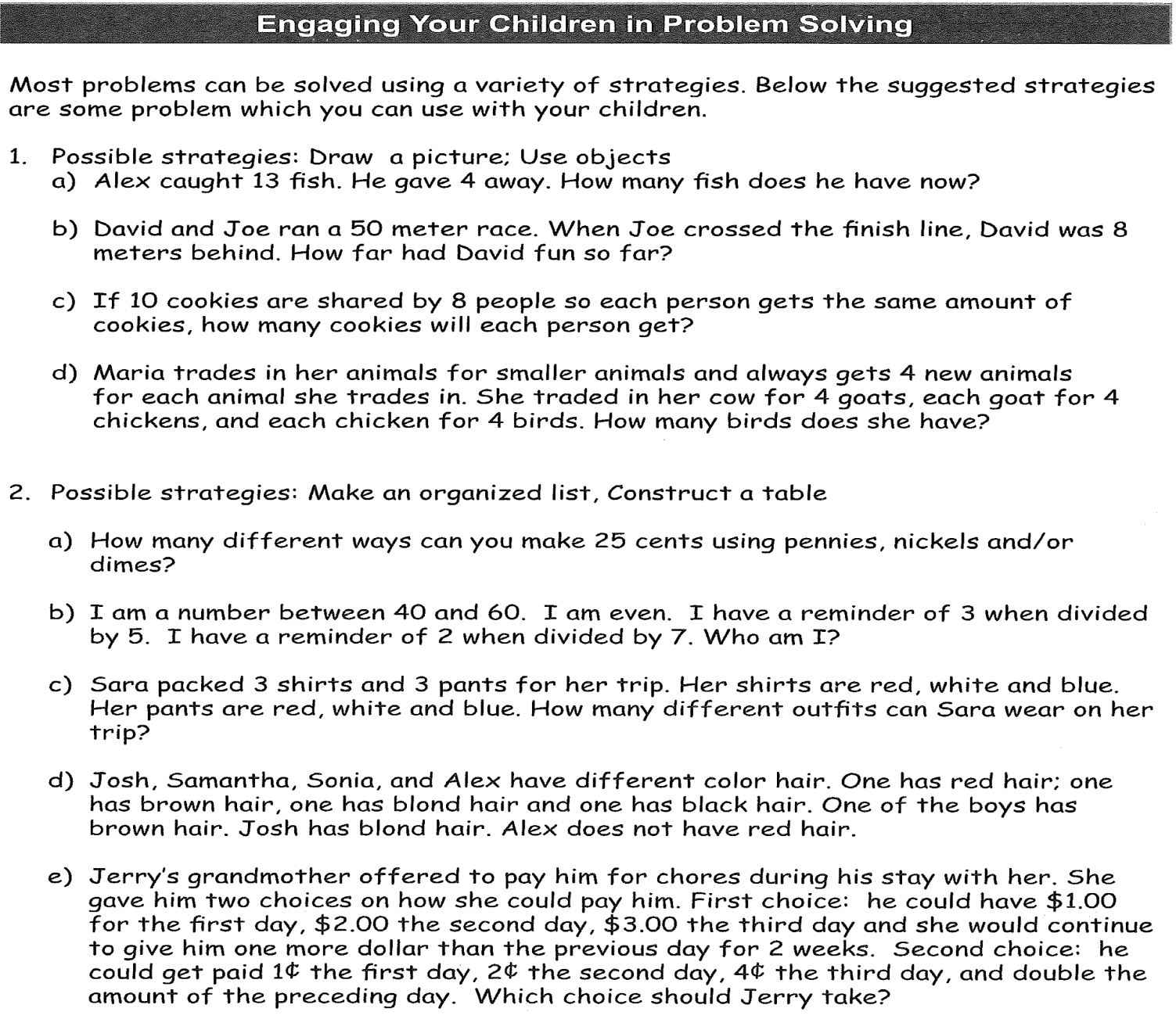
homework

Slide 14
homework
- Complete the Equations and Problem Solving handout.

Slide 15
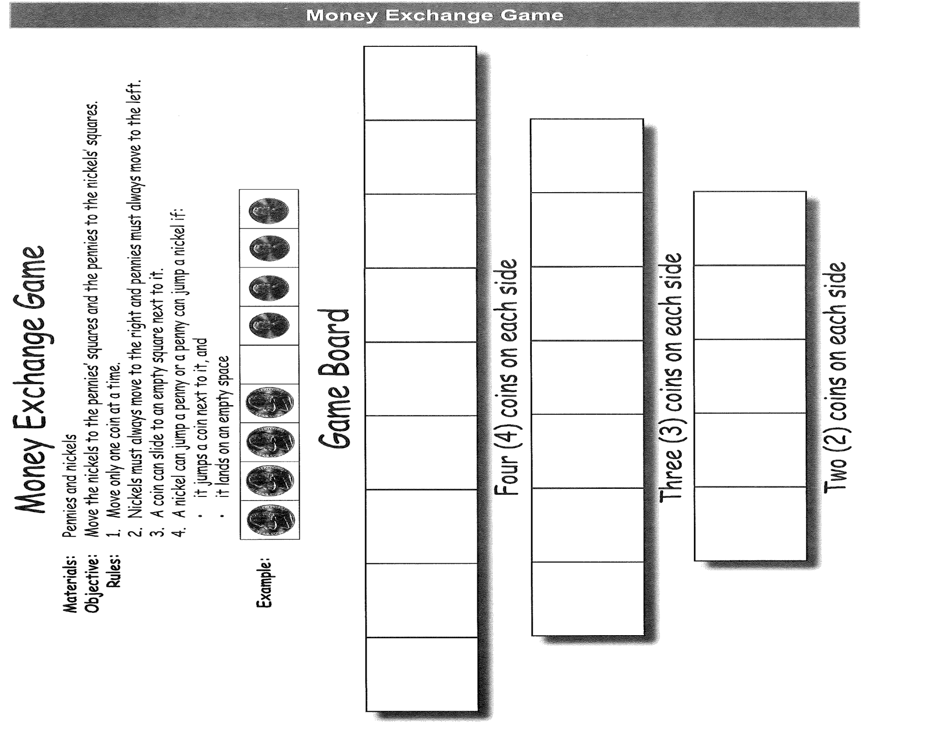

Slide 16
What did you learn today?

Slide 17
Thank you so much
See you all next week!

