Slide 1
Garage Patterns
Math and Parent Partners Workshop

Slide 2
Welcome!!!
We are glad that
you made it!

Slide 3
Styles in Tiles
Did anyone complete their Styles in Tiles activity?
Would you care to share with the group?

Slide 4
Agenda
Cognitive Guided Instruction Problems (CGI) Word Problems
Searching For Patterns activity

Slide 5
Cognitively Guided Instruction (CGI)
Raul has 4 and ⅓ bags of Taki’s in the cabinet. His mom gives him her bag and a fourth of a bag. How many bags of Taki’s does Raul have now?
Sunsara went to the mall. She spent 45. 67 on some shoes and 15.17 on a shirt. Now she has 20.45 left, how much money did she have before she purchased the shoes and the shirt?
John has eight hundred fifty three thousandths of a gallon of juice and Maria has eighty seven hundredths of a gallon of juice. Who has the most amount of juice?
Cindy has half of a gallon of milk, how many ounces of milk is this?

Slide 6
Solutions!!!!!
Talk and share!!!!

Slide 7
Solutions!!!!!
5 7/12
$81.29
Maria has the most.
64 ounces

Slide 8
Searching For Patterns
Share your patterns with the group

Slide 9
Garage Patterns
Use your blocks to build, build, build!!!!!!!!

Slide 10
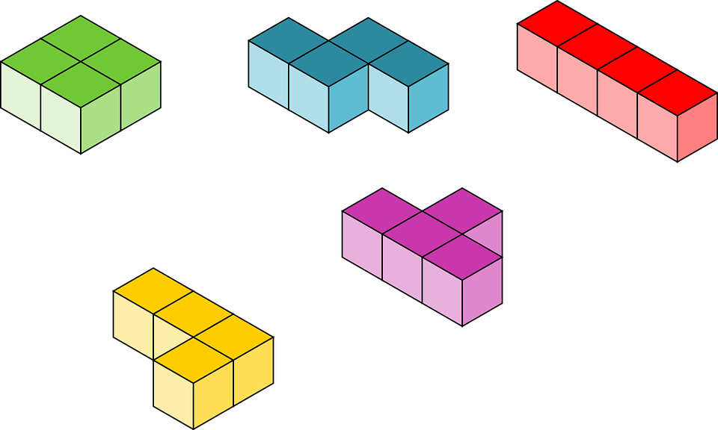
Garage Patterns!
How many blocks will I need for 9 garages?
What patterns did you discuss with your partner?
What kind of rule or generalization were you able to write?

Slide 11
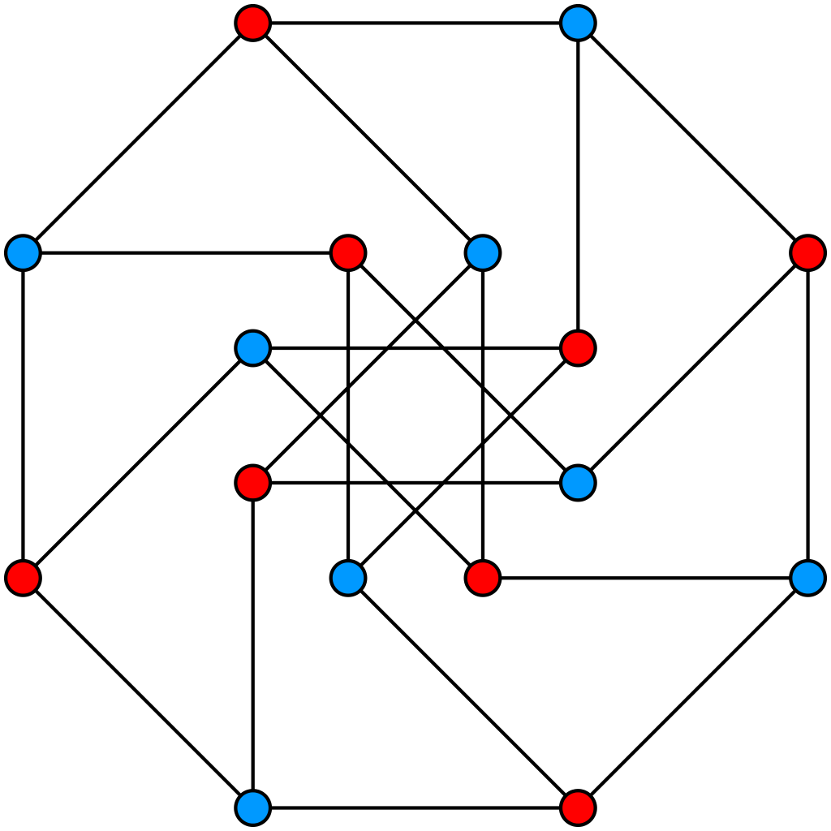
Graphing Patterns! Garage Graph BLM 17
Let’s label the x-axis, “Number of Garages” from 1-9 on the lines.
Let’s label the y-axis, “Number of Blocks” from 1-46
Plot the points for building one garage, two garages, and three garages.
Complete the graph.
What do you notice?

Slide 12
CONGRATULATIONS!!!!!!!
We would like to thank all of you for your time and your energy for participating in the MAPS Program! We look forward to seeing you next season!!!

