Slide 1
Session eight

Slide 2
Let’s look at the homework!

Slide 3
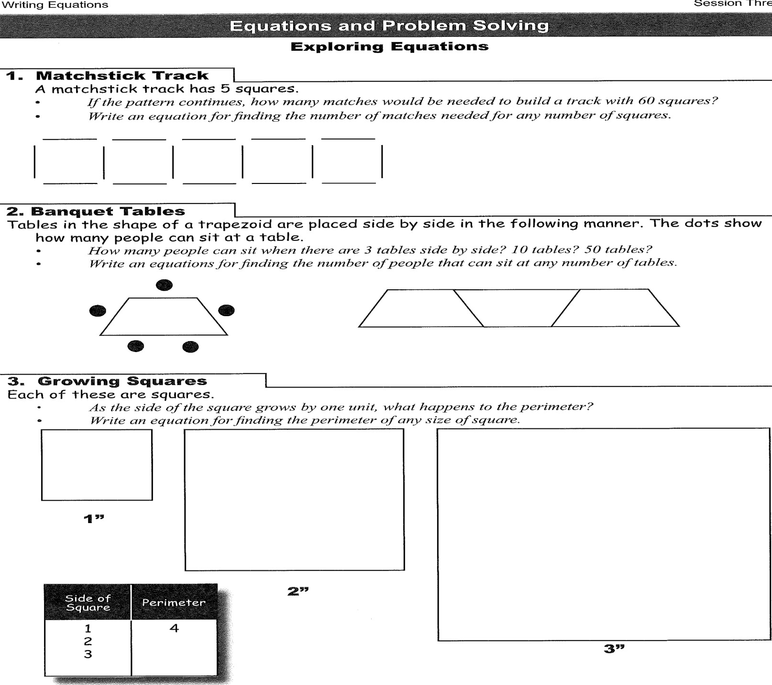
homework

Slide 4
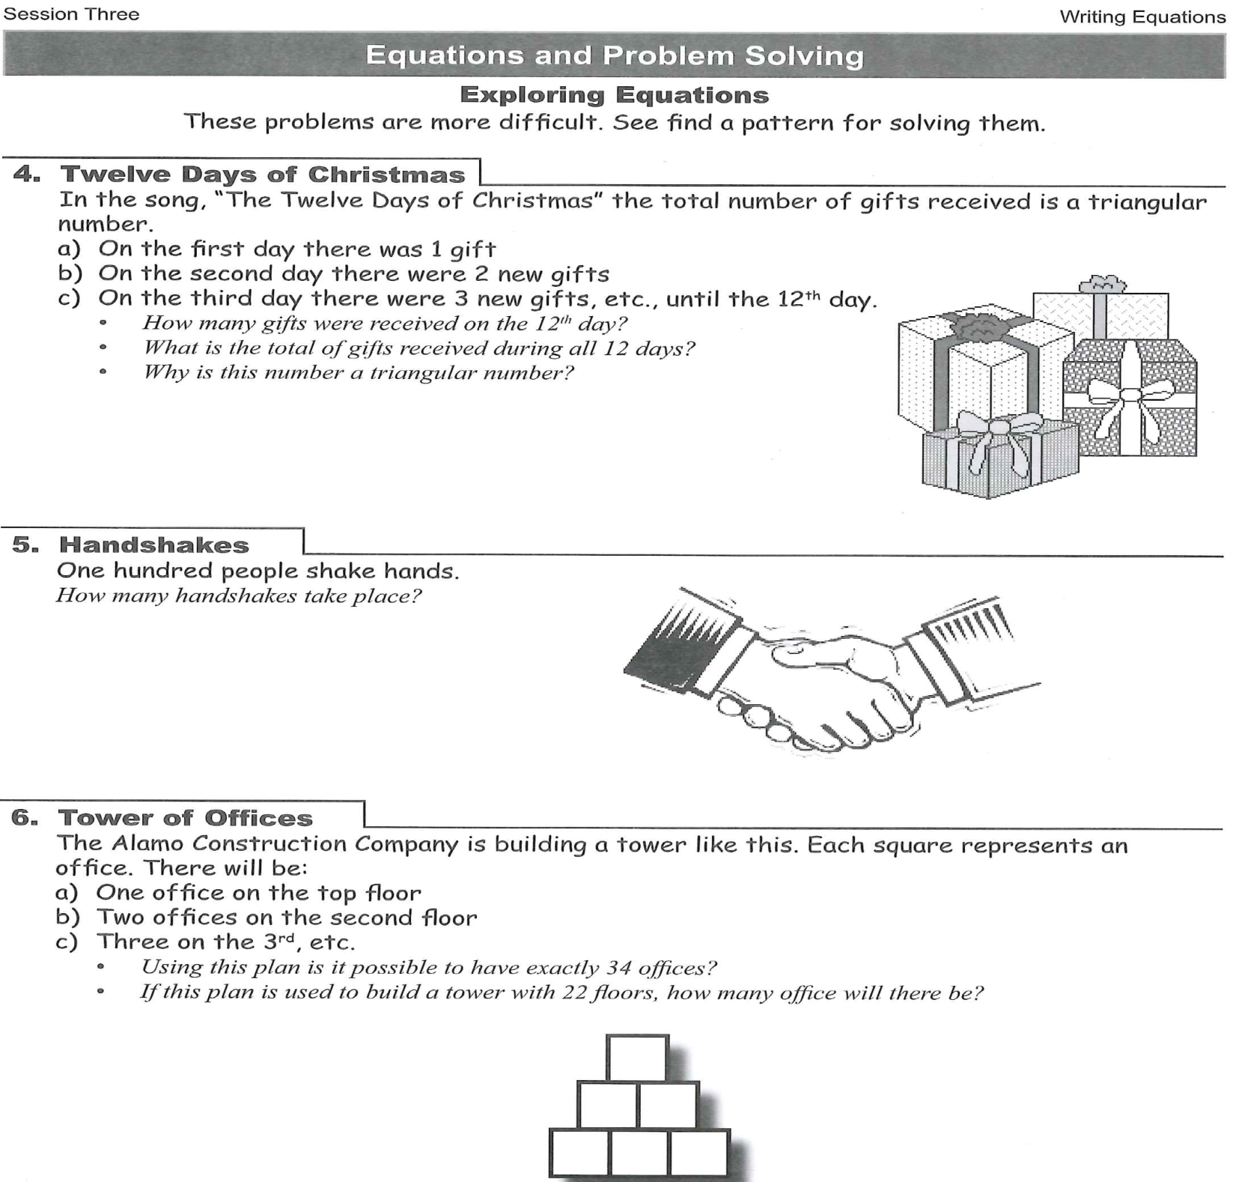

Slide 5
A few questions…..

Slide 6
How do you complete a table from an equation?

Slide 7
How do you find an equation from a table?

Slide 8
How do you graph from a table?

Slide 9
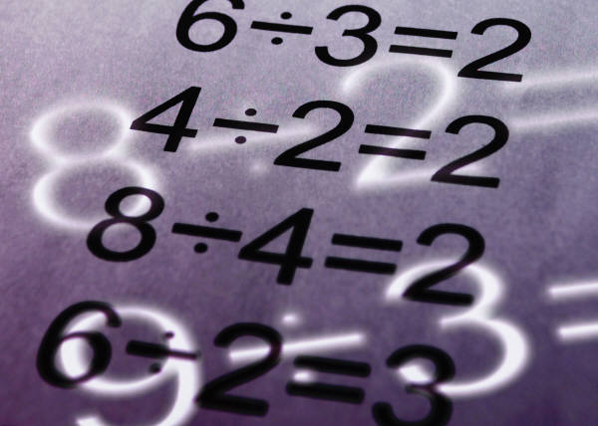
Solving equations

Slide 11
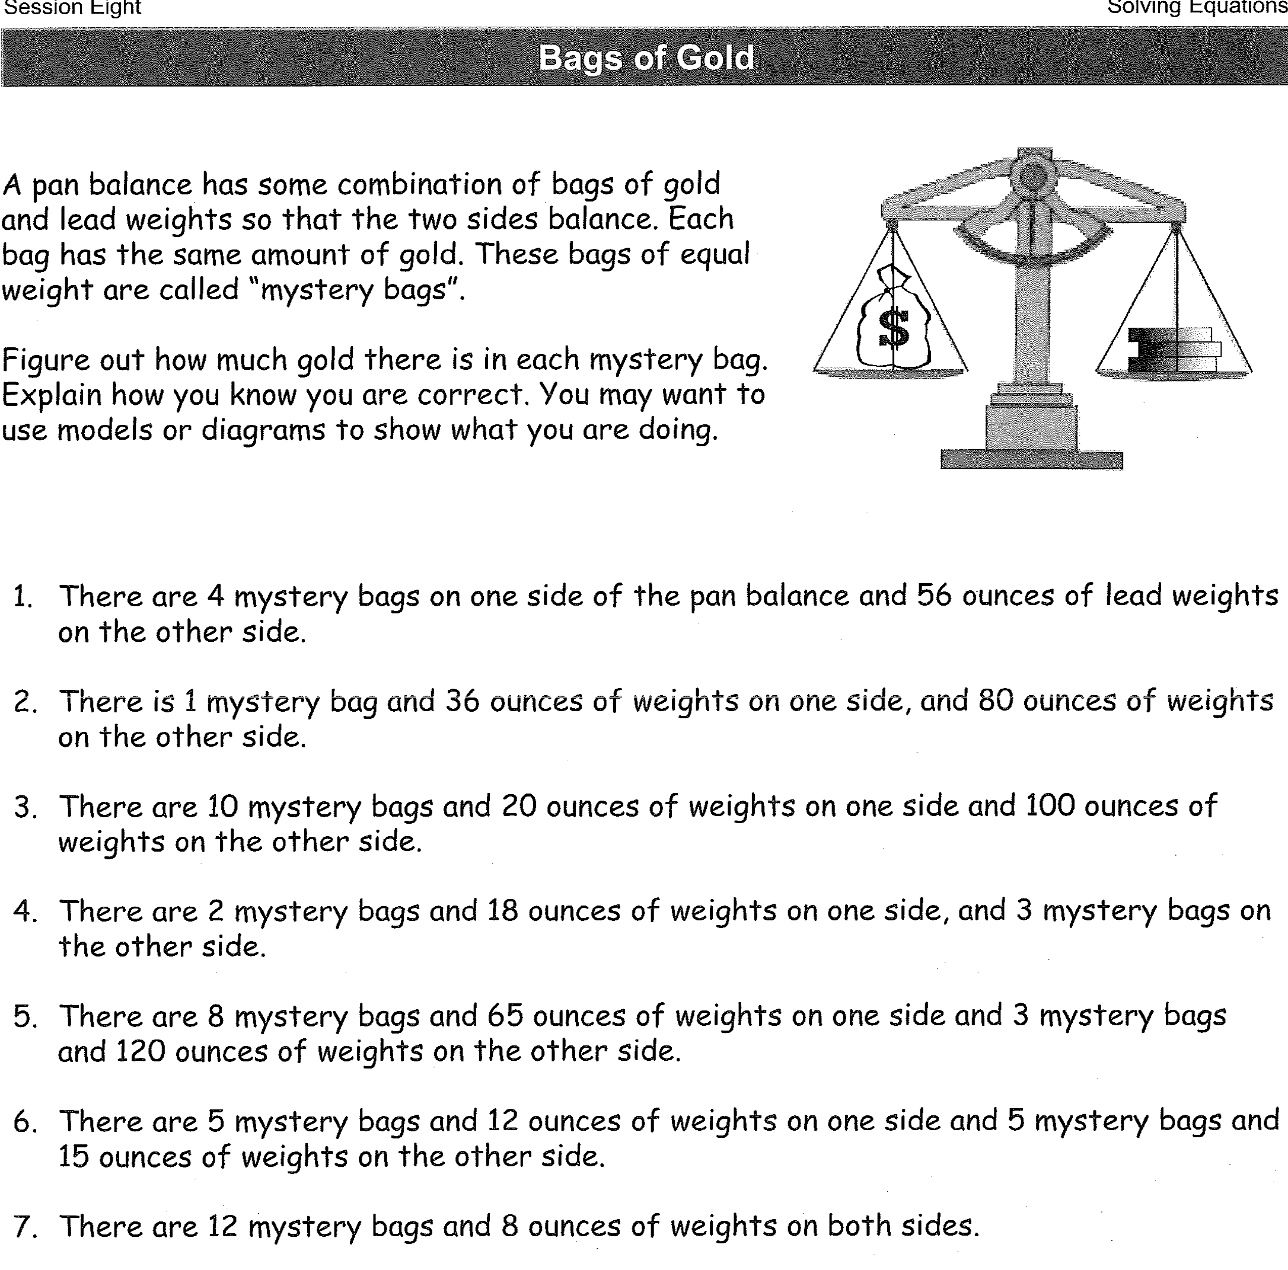

Slide 12
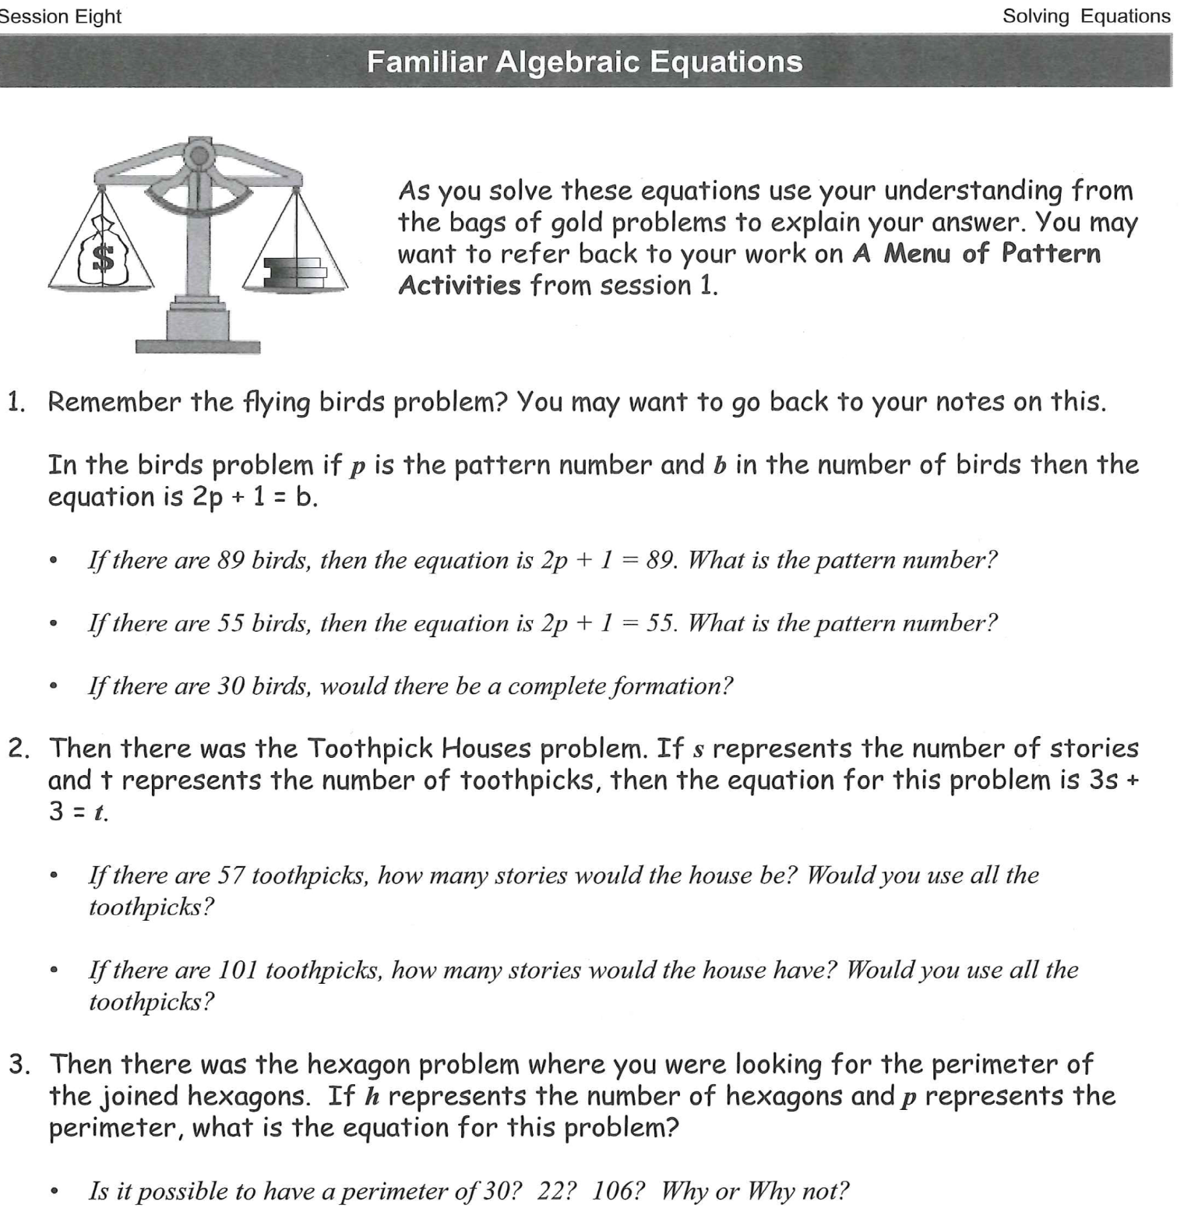

Slide 13
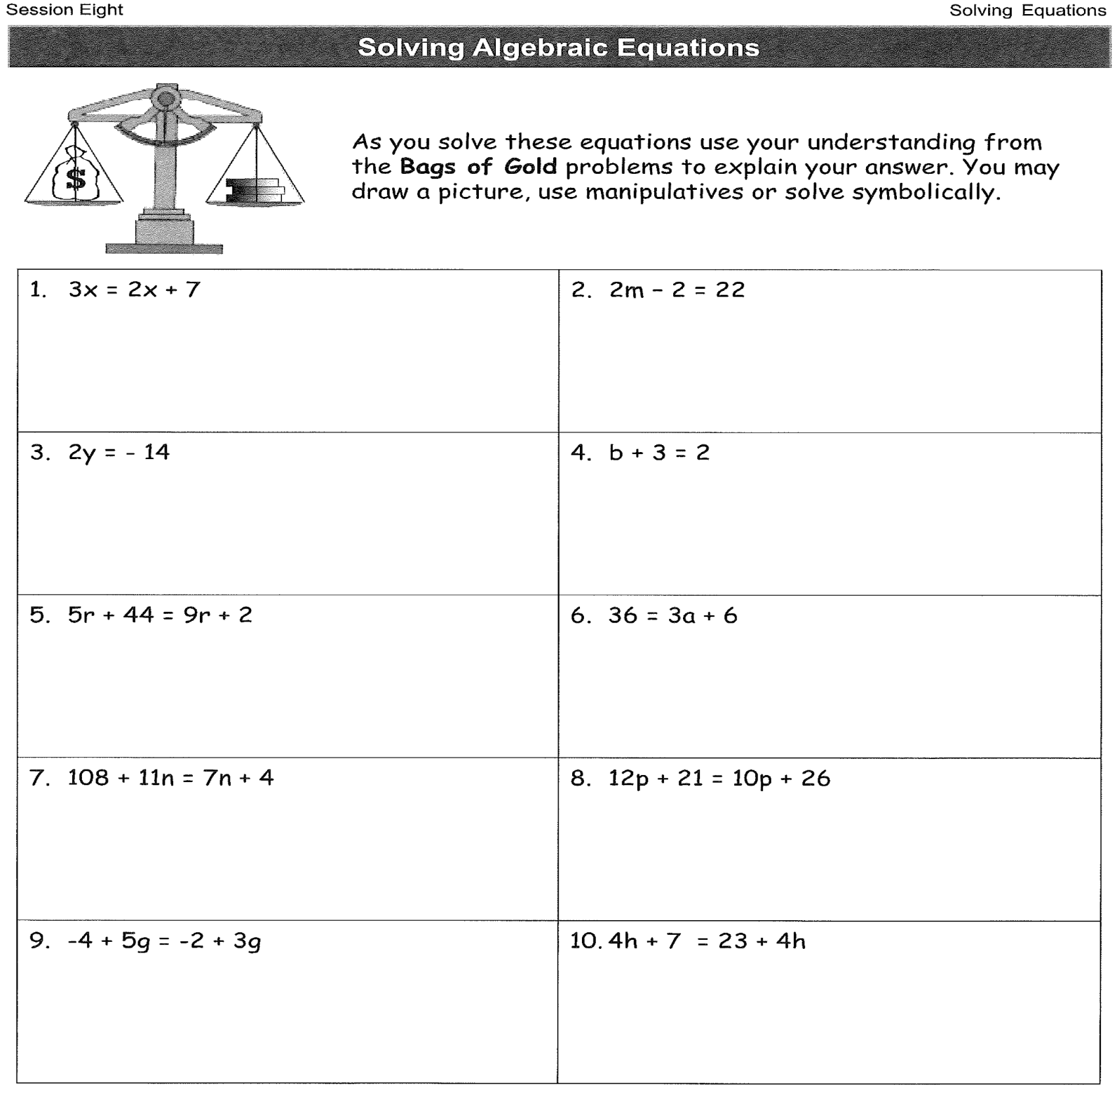

Slide 14
Closing activity
What experiences did you have during the sessions?

Slide 15
I had fun with numbers
I learned some math words

Slide 16

Thank you so much let’s celebrate!

