Slide 1
Session four

Slide 2
Let’s look at the homework!

Slide 5
Question 1 – Matchstick track
Number of Squares, S | No. of Matchsticks, M | Pattern
1 | 4 | 3(1) + 1 = 4
2 | 7 | 3(2) + 1 = 7
3 | 10 | 3(3) + 1 = 10
4 | 13 | 3(4) + 1 = 13
5 | 16 | 3(5) + 1 = 16
S | M | 3(S) + 1 = M
60 | 181 | 3(60) + 1 = 181

Slide 6
Question 2 – banquet tables
Number of Tables, T | Number of People, P | Pattern
1 | 5 | 3(1) + 2 = 4
2 | 8 | 3(2) + 2 = 7
3 | 11 | 3(3) + 2 = 10
T | P | 3(T) + 2 = P
10 | 32 | 3(10) + 2 = 32
50 | 152 | 3(50) + 2 = 152

Slide 7
Question 3 – Growing Squares
Side of Square, S | Perimeter, P | Pattern
1 | 4 | 4(1) = 4
2 | 8 | 4(2) = 8
3 | 12 | 4(3) = 12
4 | 16 | 4(4) = 16
S | P | 4(S) = P

Slide 8
Question 4 – twelve days of christmas
Day, D | Number of Gifts, G | Pattern
1 | 1 | 1
2 | 3 | 1+2=3
3 | 6 | 1+2+3=6
4 | 10 | 1+2+3+4=10
5 | 15 | 1+2+3+4+5=15
6 | 21 | 1+2+3+4+5+6=21
7 | 28 | 1+2+3+4+5+6+7=28
8 | 36 | 1+2+3+4+5+6+7+8=36
9 | 45 | 1+2+3+4+5+6+7+8+9=45
10 | 55 | 1+2+3+4+5+6+7+8+9+10=55
11 | 66 | 1+2+3+4+5+6+7+8+9+10+11=66
12 | 78 | 1+2+3+4+5+6+7+8+9+10+11+12=78
D | G | D (D + 1) = G 2

Slide 9
Question 5 – handshakes
Number of People, P | No. of Handshakes, H | Pattern
1 | 0 | None (yet!)
2 | 1 | Similar
3 | 3 | to
4 | 6 | the
5 | 10 | diagonal
6 | 15 | solution
P | H | P (P-1) = H 2

Slide 10
Question 6 – tower of offices
Number of Floors, F | Number of Offices, N | Pattern
1 | 1 | 1
2 | 3 | 1+2=3
3 | 6 | 1+2+3=6
4 | 10 | 1+2+3+4=10
5 | 15 | 1+2+3+4+5=15
6 | 21 | 1+2+3+4+5+6=21
7 | 28 | 1+2+3+4+5+6+7=28
8 | 36 | 1+2+3+4+5+6+7+8=36
F | N | F (F + 1) = N 2
22 | 253 | (22)(23)/2=253

Slide 11
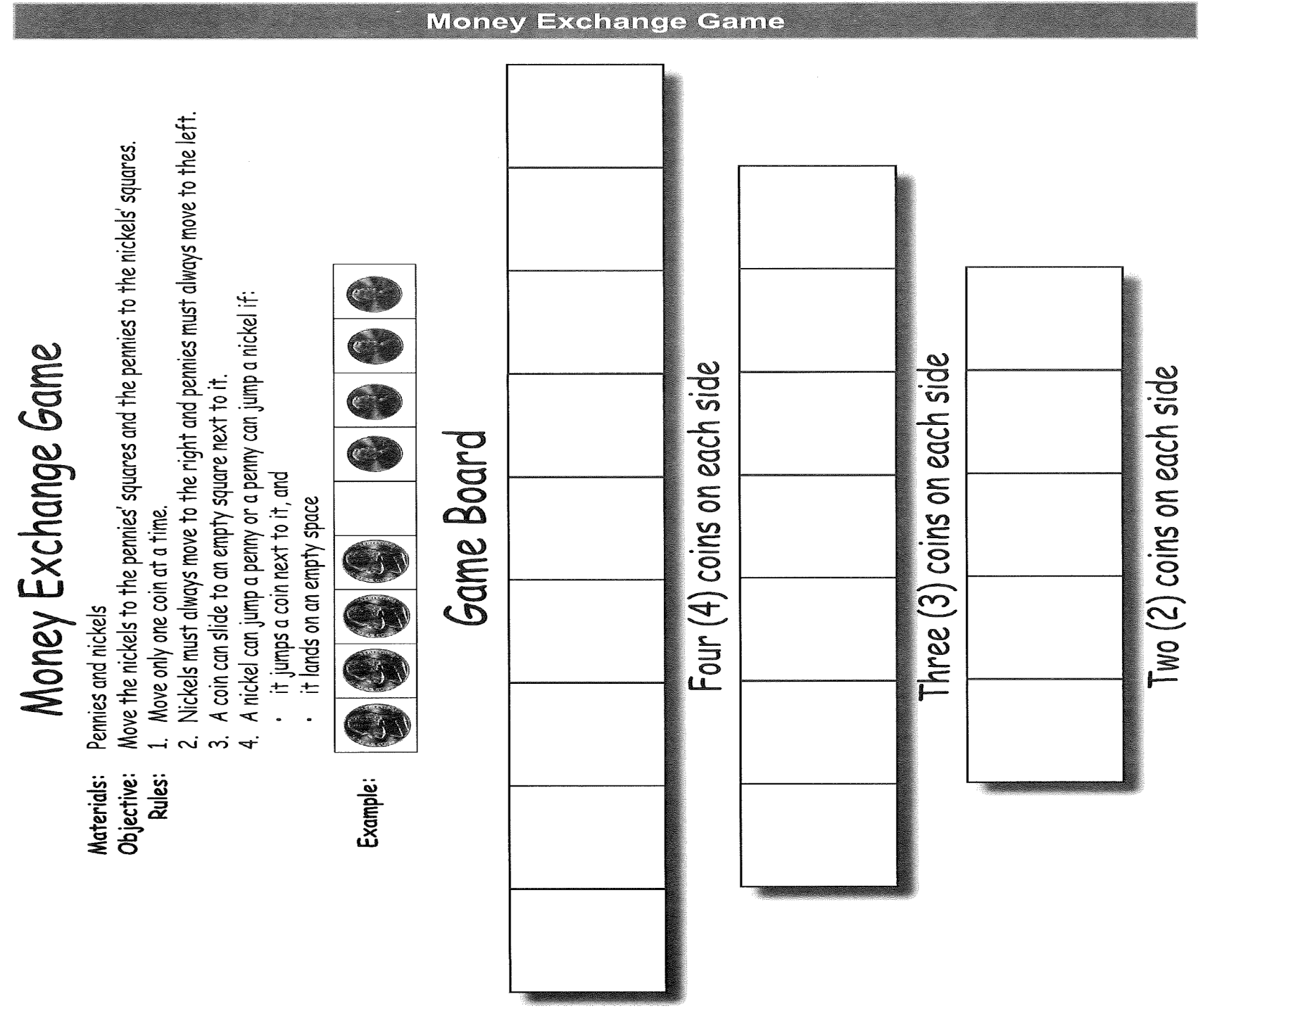
Money exchange game

Slide 12
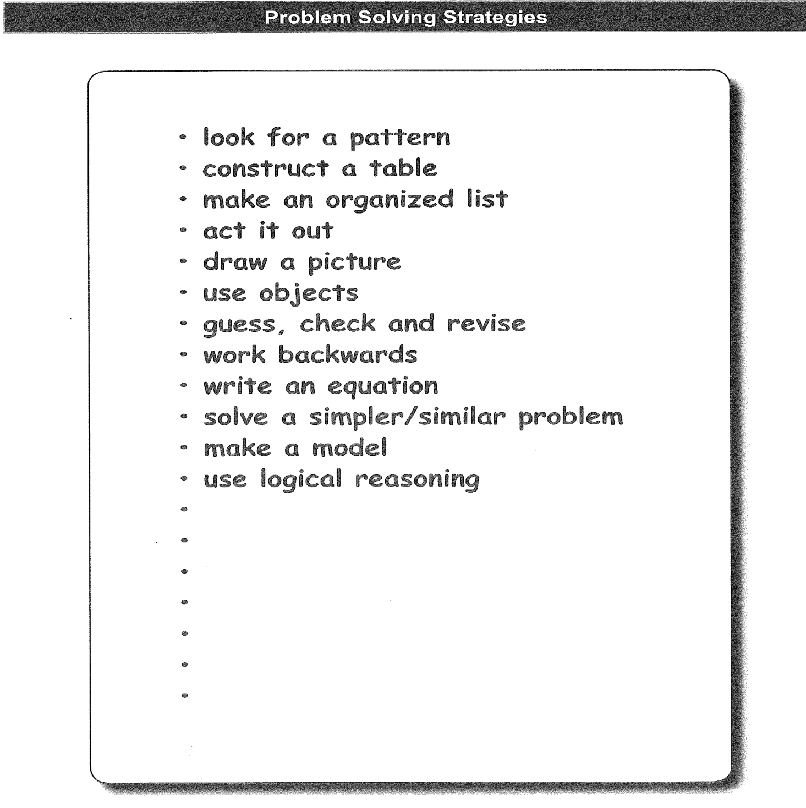
Problem solving strategies

Slide 13
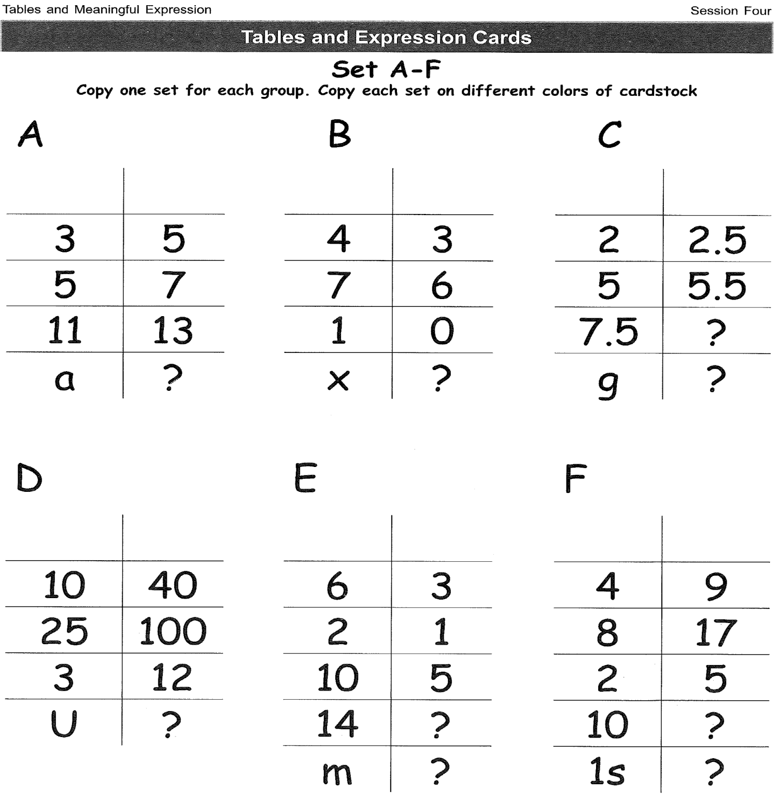

Slide 14
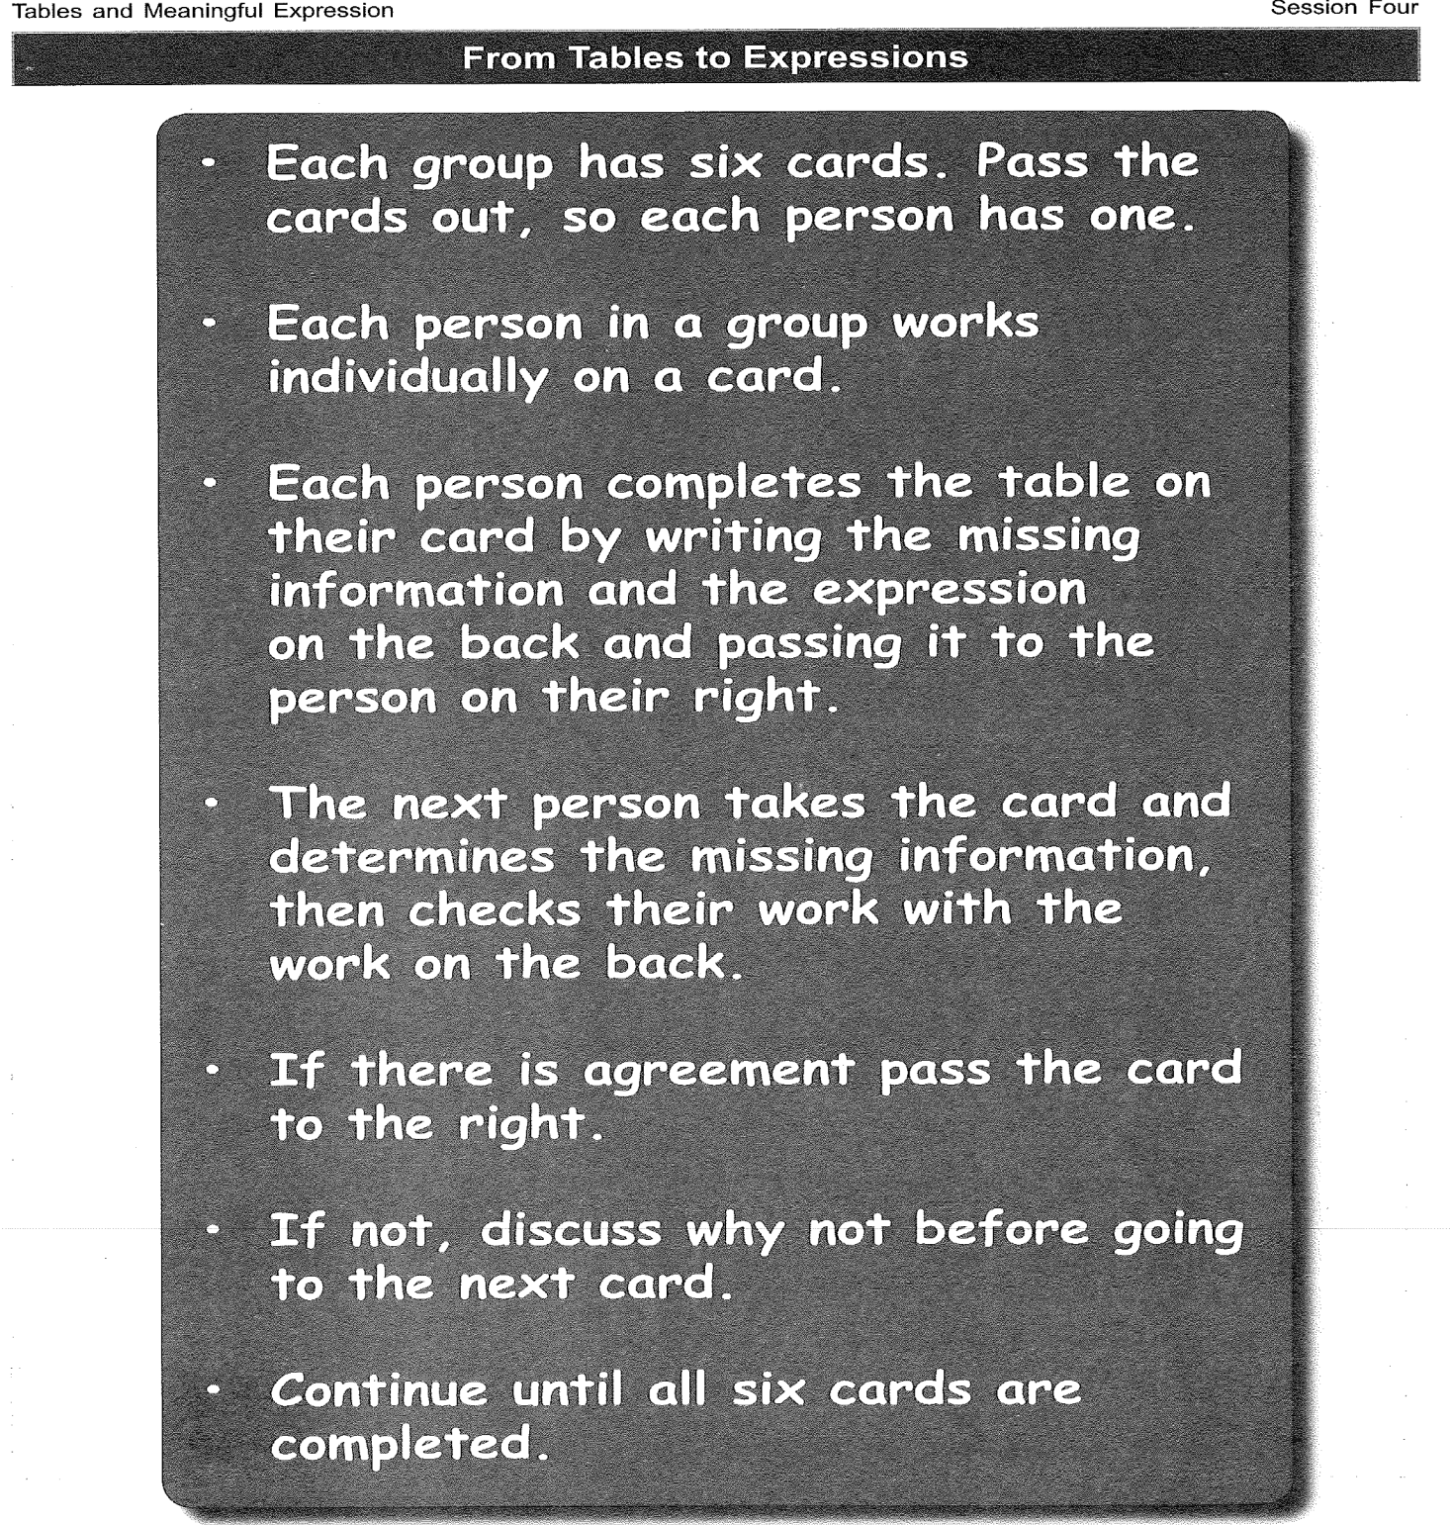

Slide 15
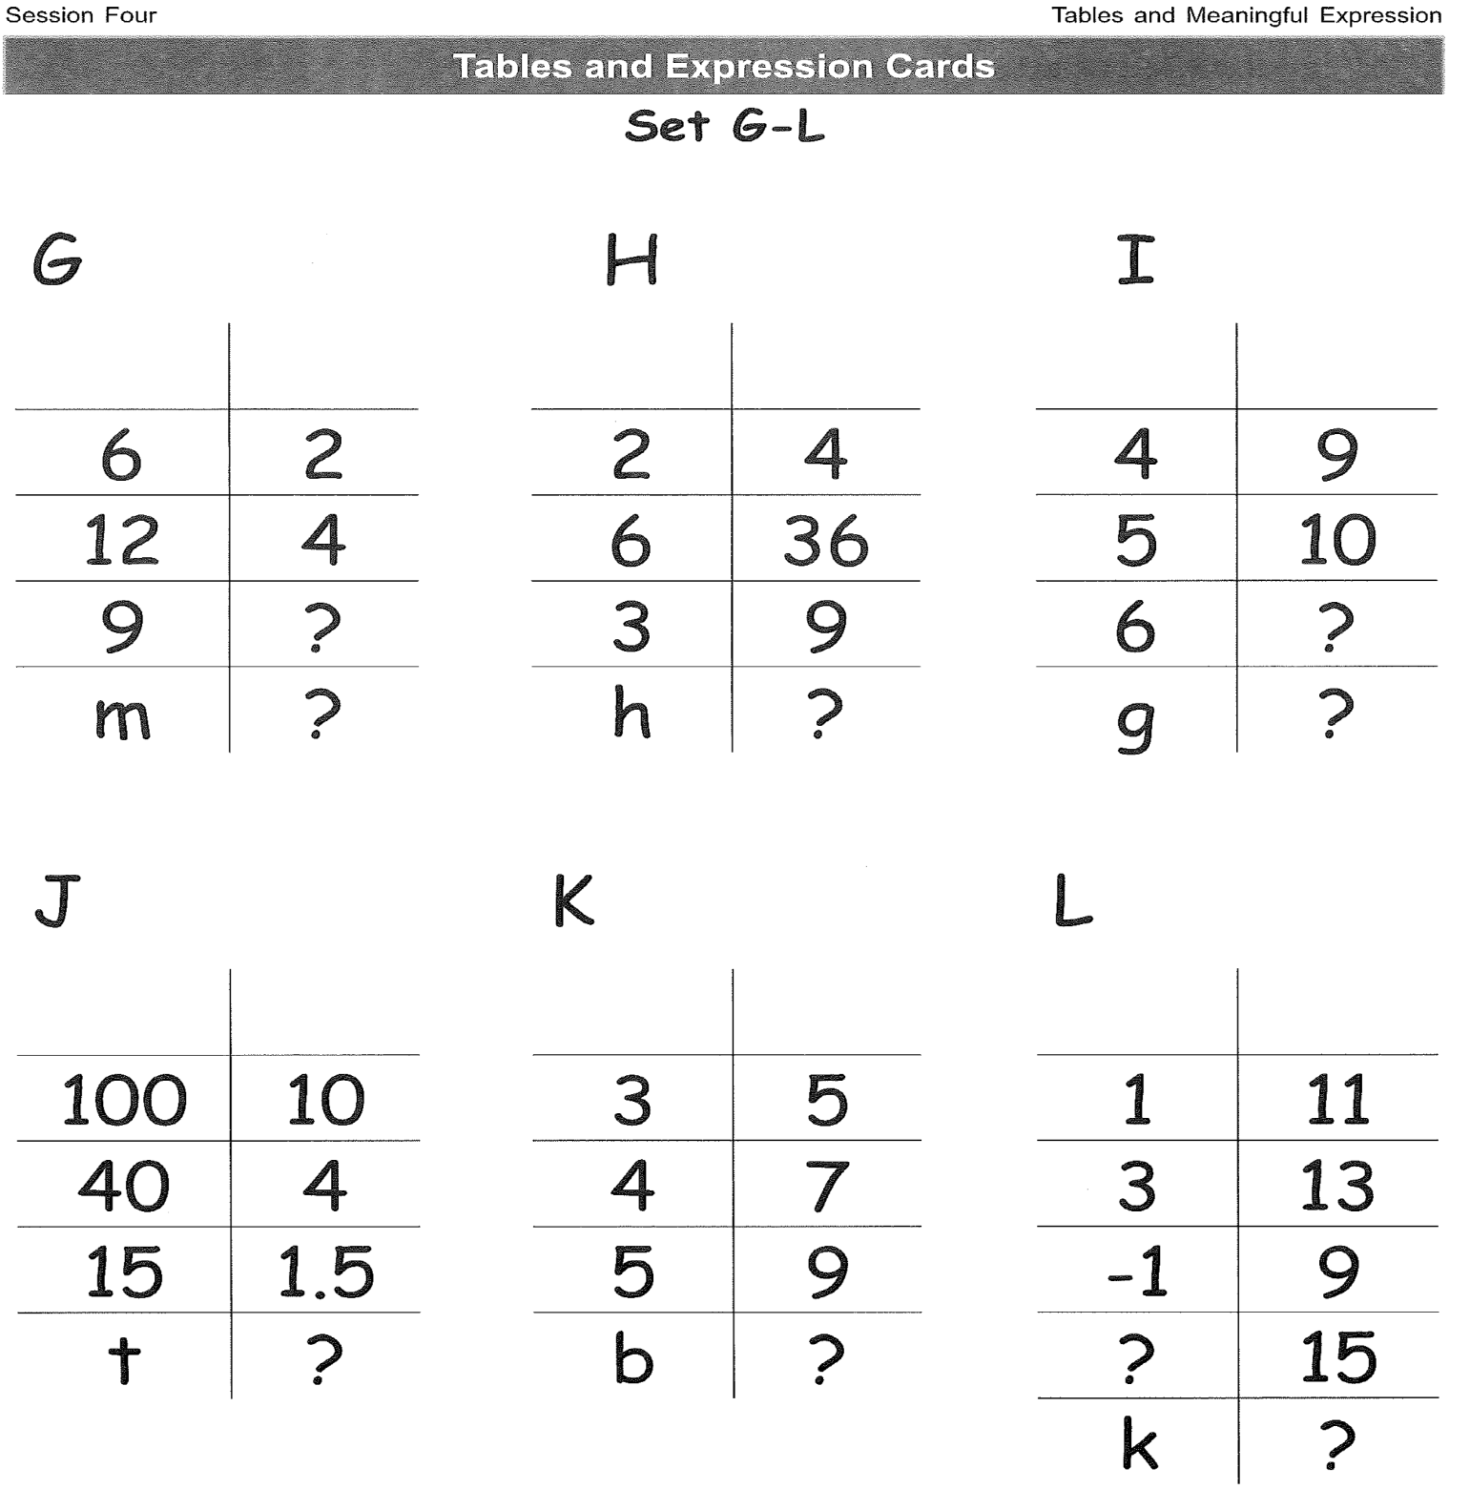

Slide 16
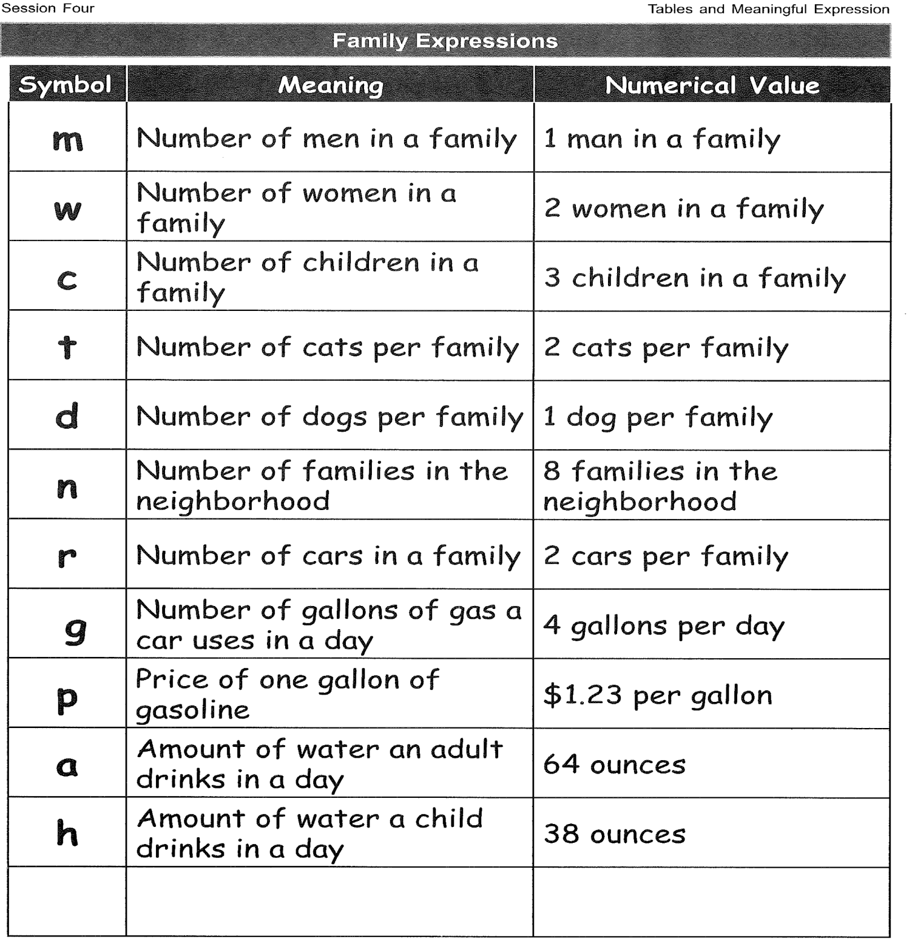

Slide 17
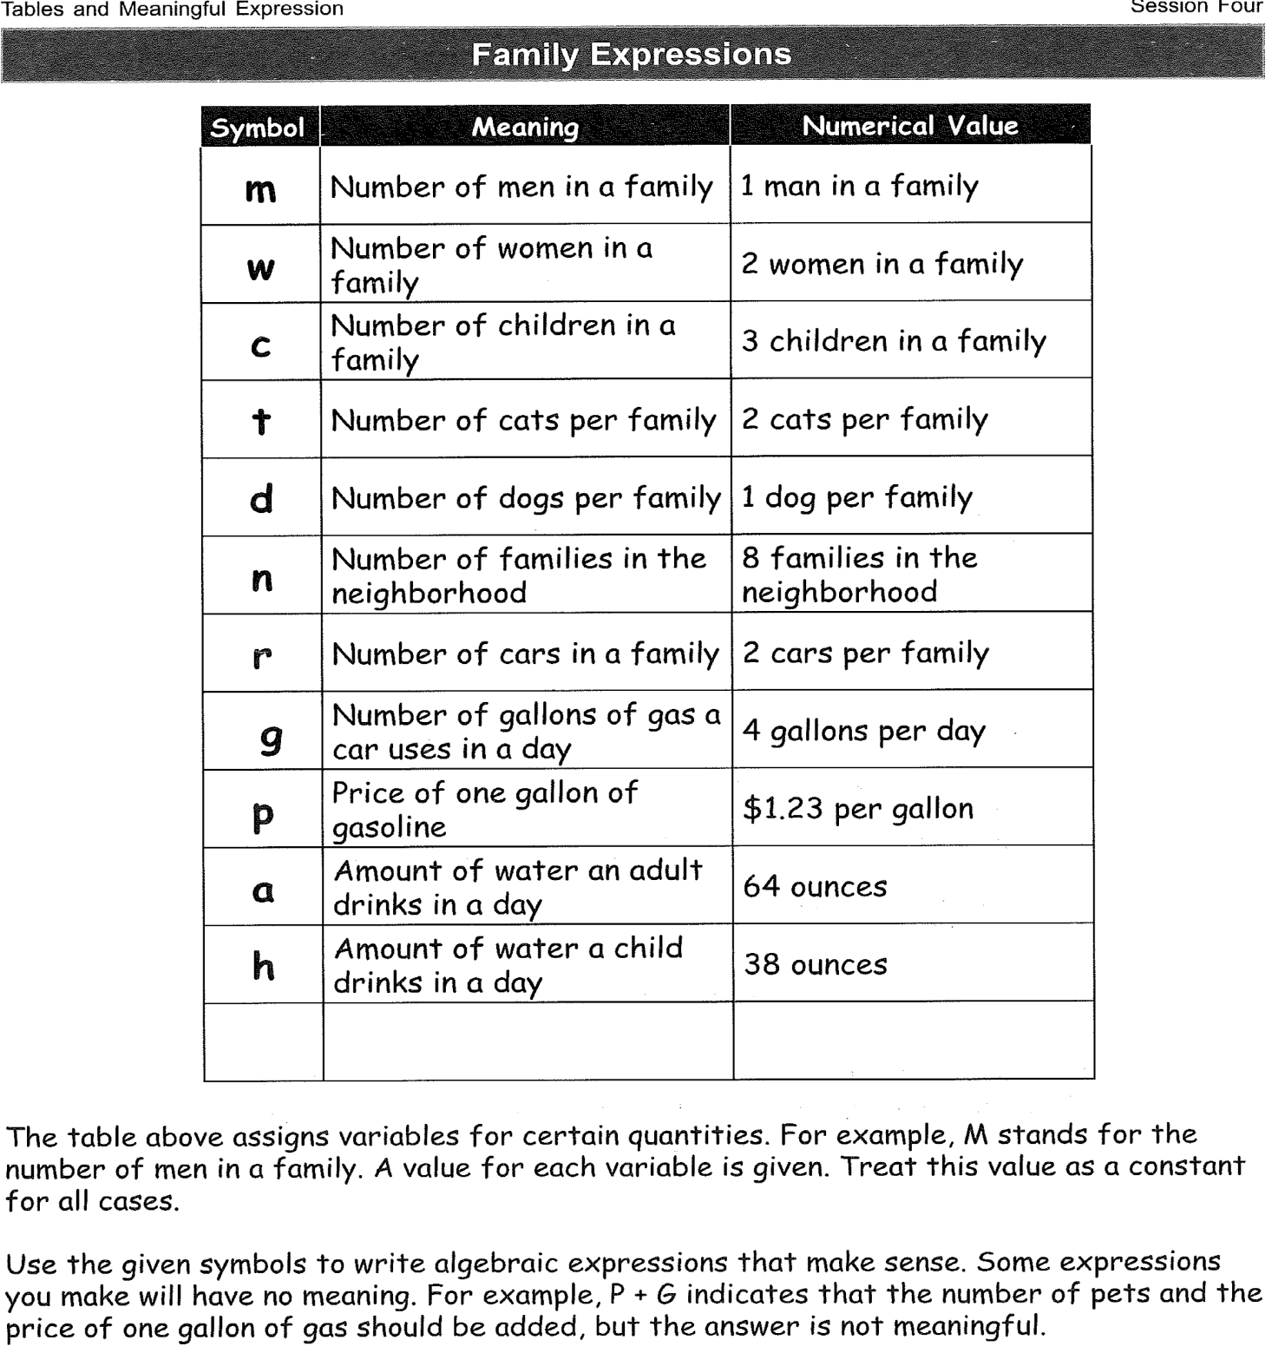

Slide 18
Expression: m + w
Equation: f = m + w

Slide 19
What is algebra?

Slide 20
How does one learn algebra?

Slide 21
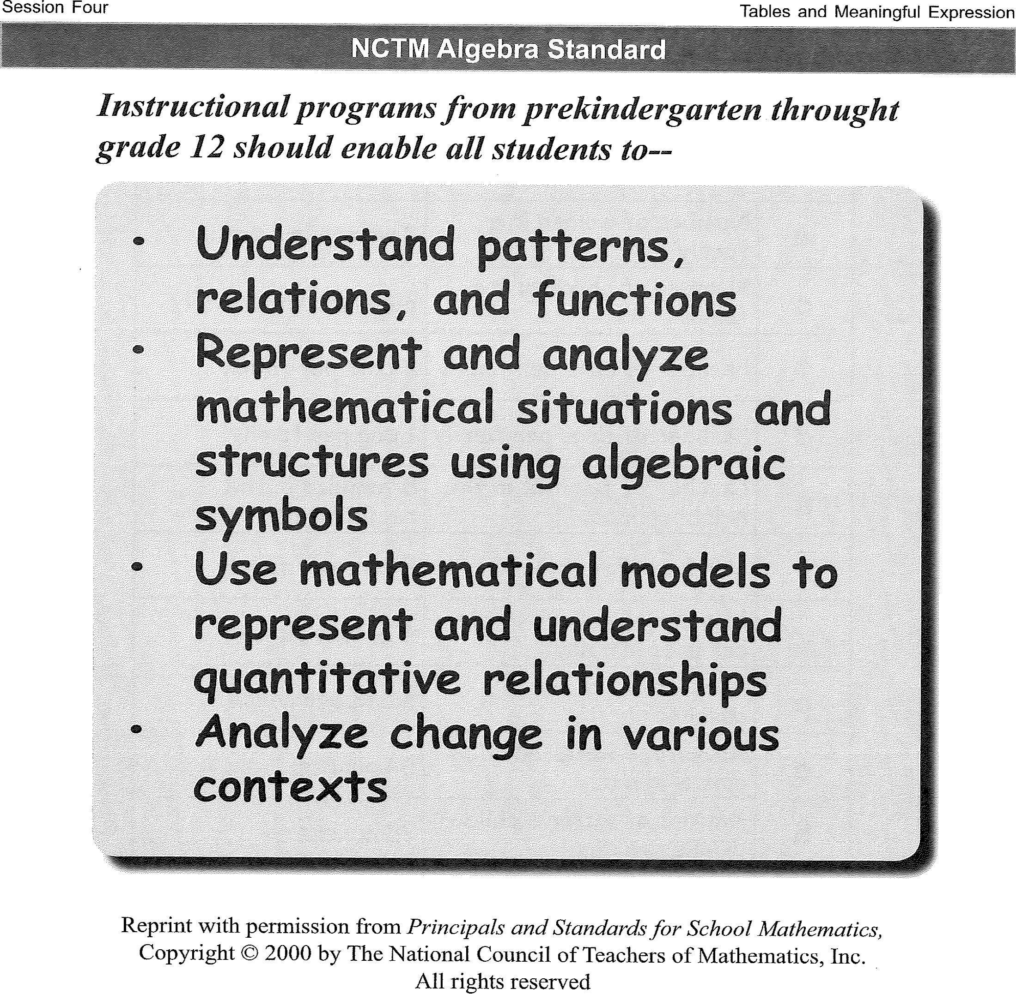

Slide 22
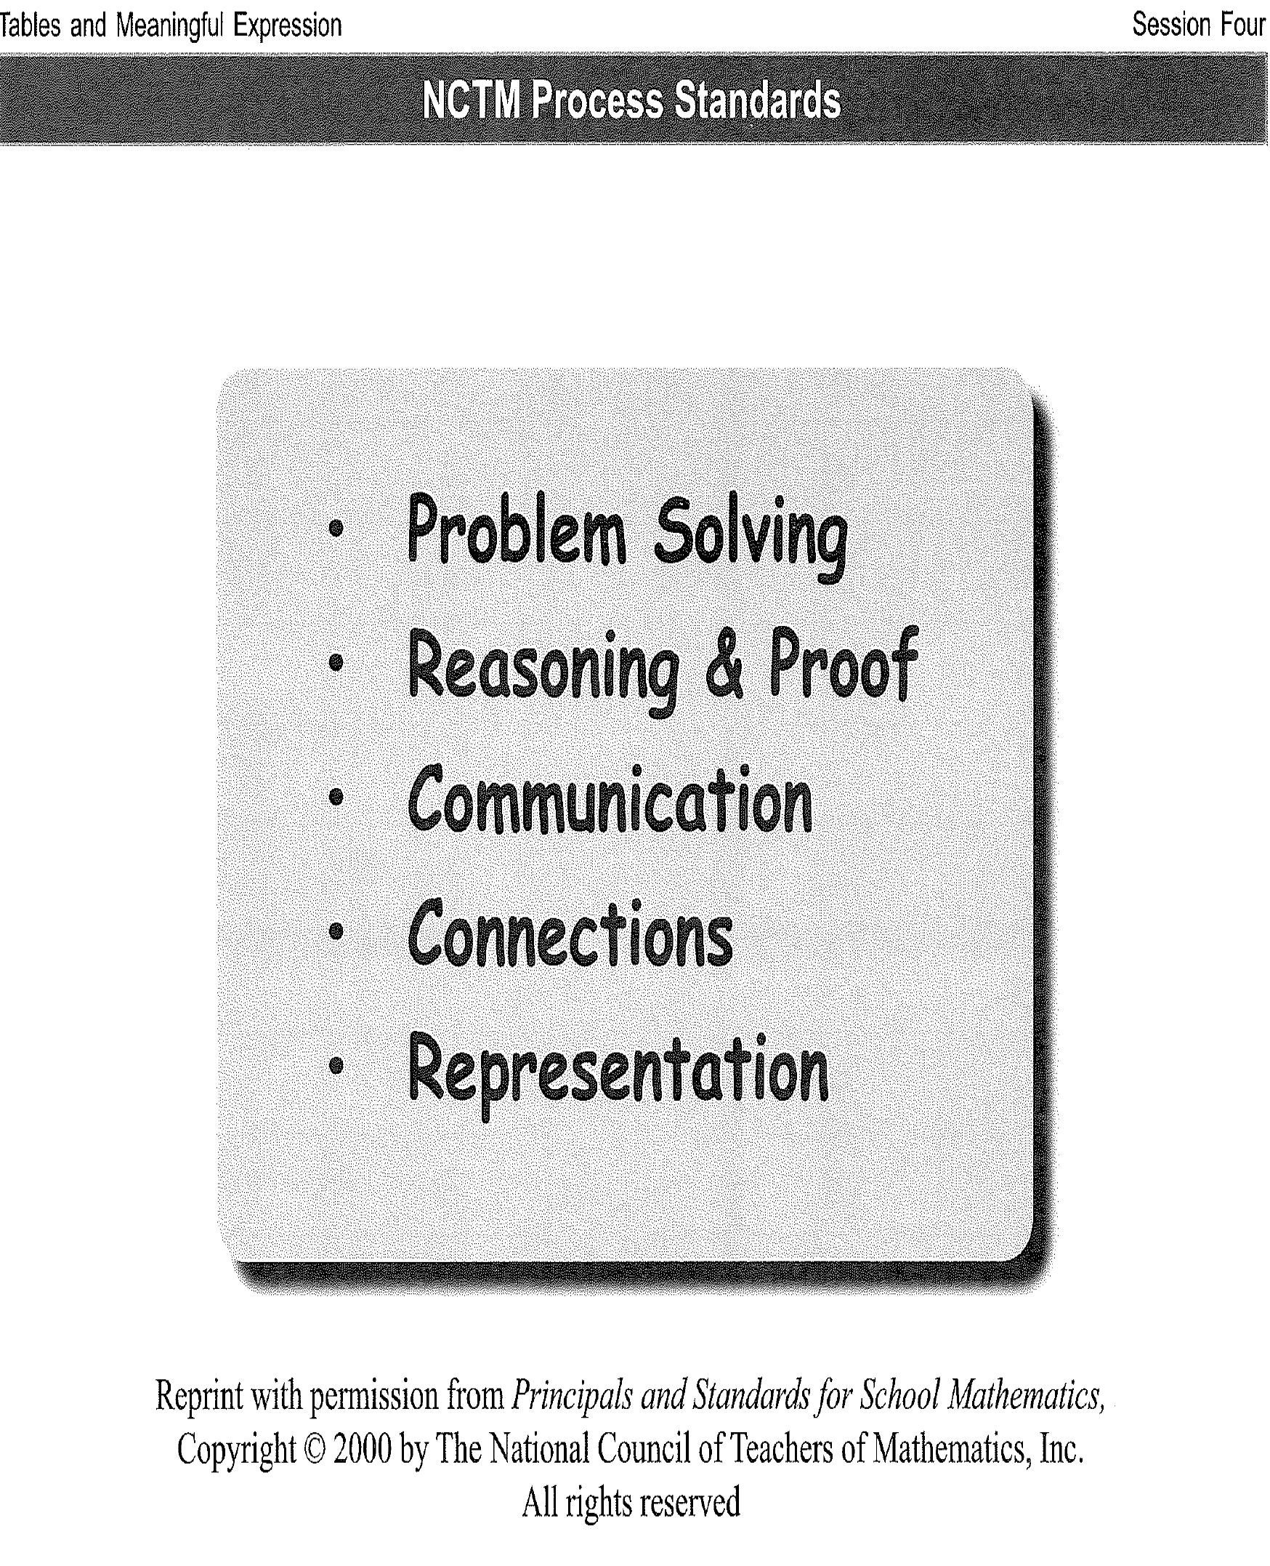

Slide 23
nctm.org

Slide 24
question
How would you help children get ready for algebra?

Slide 25
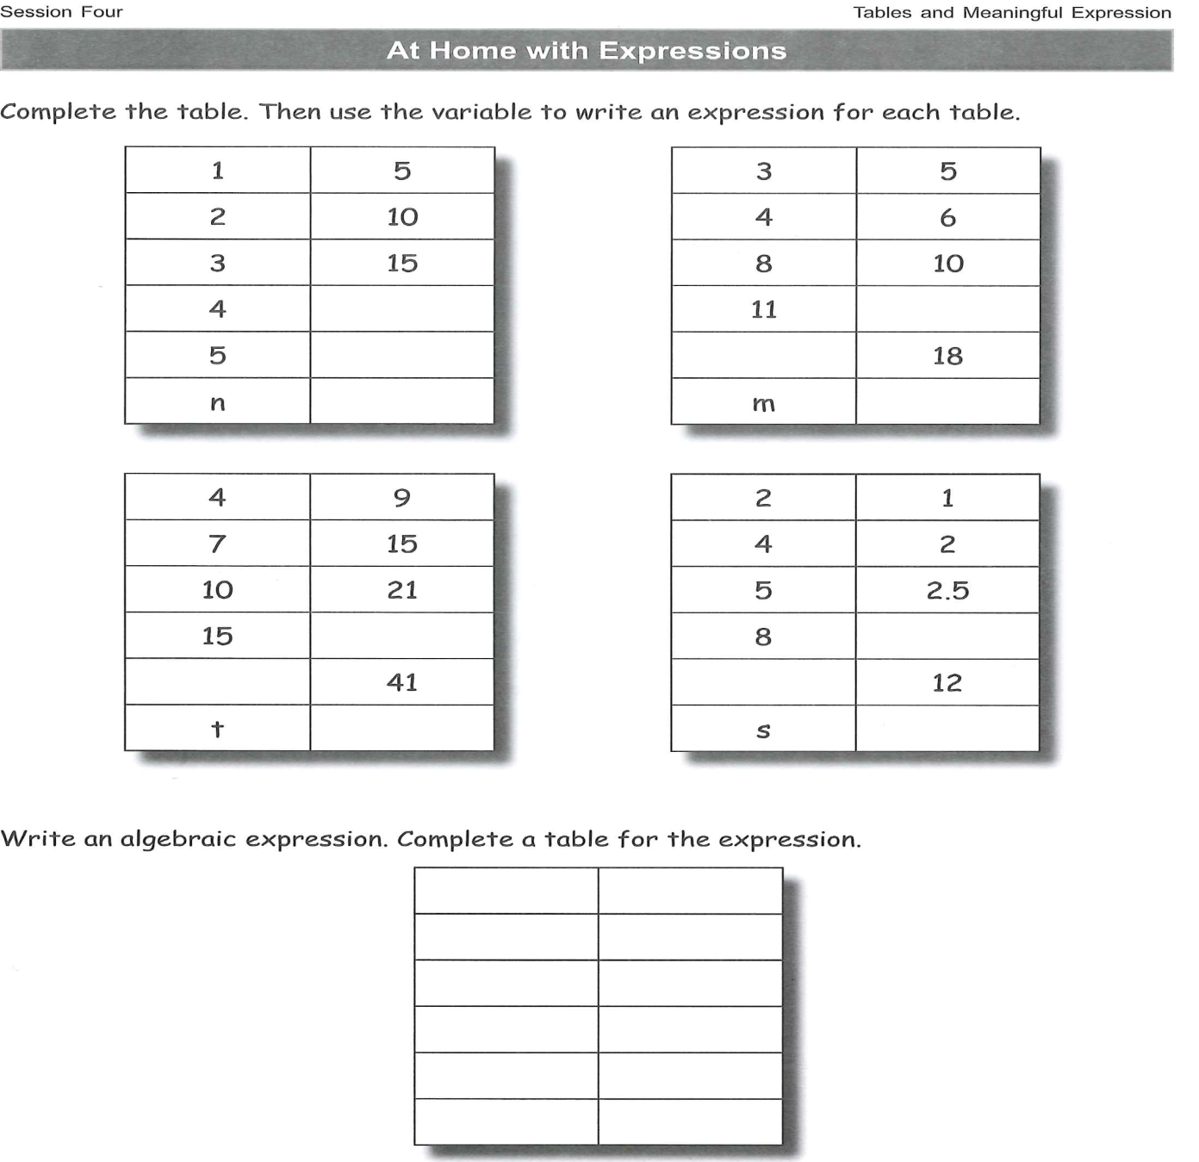
homework

Slide 26
Thank you so much
See you all next week!

