Slide 1
Session TWO

Slide 2
Let’s look at the homework!

Slide 3
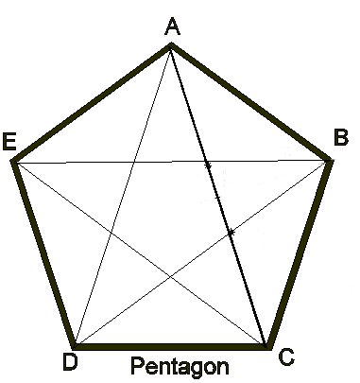
Diagonals of polygons
Q: What is a diagonal?
A: Diagonals are line segments that connect one corner (vertex) to another, but not the sides.
A pentagon (5-sides)
has 5 diagonals.

Slide 4
Do you see a pattern?
Number of corners | Number of diagonals from each corner | Pattern
5 | 2
6 | 3
7 | 4
8 | 5
9 | 6
10

Slide 5
Do you see a pattern?
Number of corners | Number of diagonals from each corner | Pattern
5 | 2 | Subtract 3
6 | 3 | Subtract 3
7 | 4 | Subtract 3
8 | 5 | Subtract 3
9 | 6 | Subtract 3
10 | 7 | Subtract 3

Slide 6
Number of corners | Number of diagonals from each corner | Total number of lines
5 | 2 | 5 x 2 = 10
6 | 3 | 6 x 3 = 18
7 | 4 | 7 x 4 = 28
8 | 5 | 8 x 5 = 40
9 | 6 | 9 x 6 = 54
10 | 7 | 10 x 7 = 70

Slide 7
Number of corners | Number of diagonals from each corner | Total number of lines | Number of diagonals
5 | 2 | 5 x 2 = 10 | 10/2 = 5
6 | 3 | 6 x 3 = 18 | 18/2 = 9
7 | 4 | 7 x 4 = 28 | 28/2 = 14
8 | 5 | 8 x 5 = 40 | 40/2 = 20
9 | 6 | 9 x 6 = 54 | 54/2 = 27
10 | 7 | 10 x 7 = 70 | 70/2 = 35

Slide 8
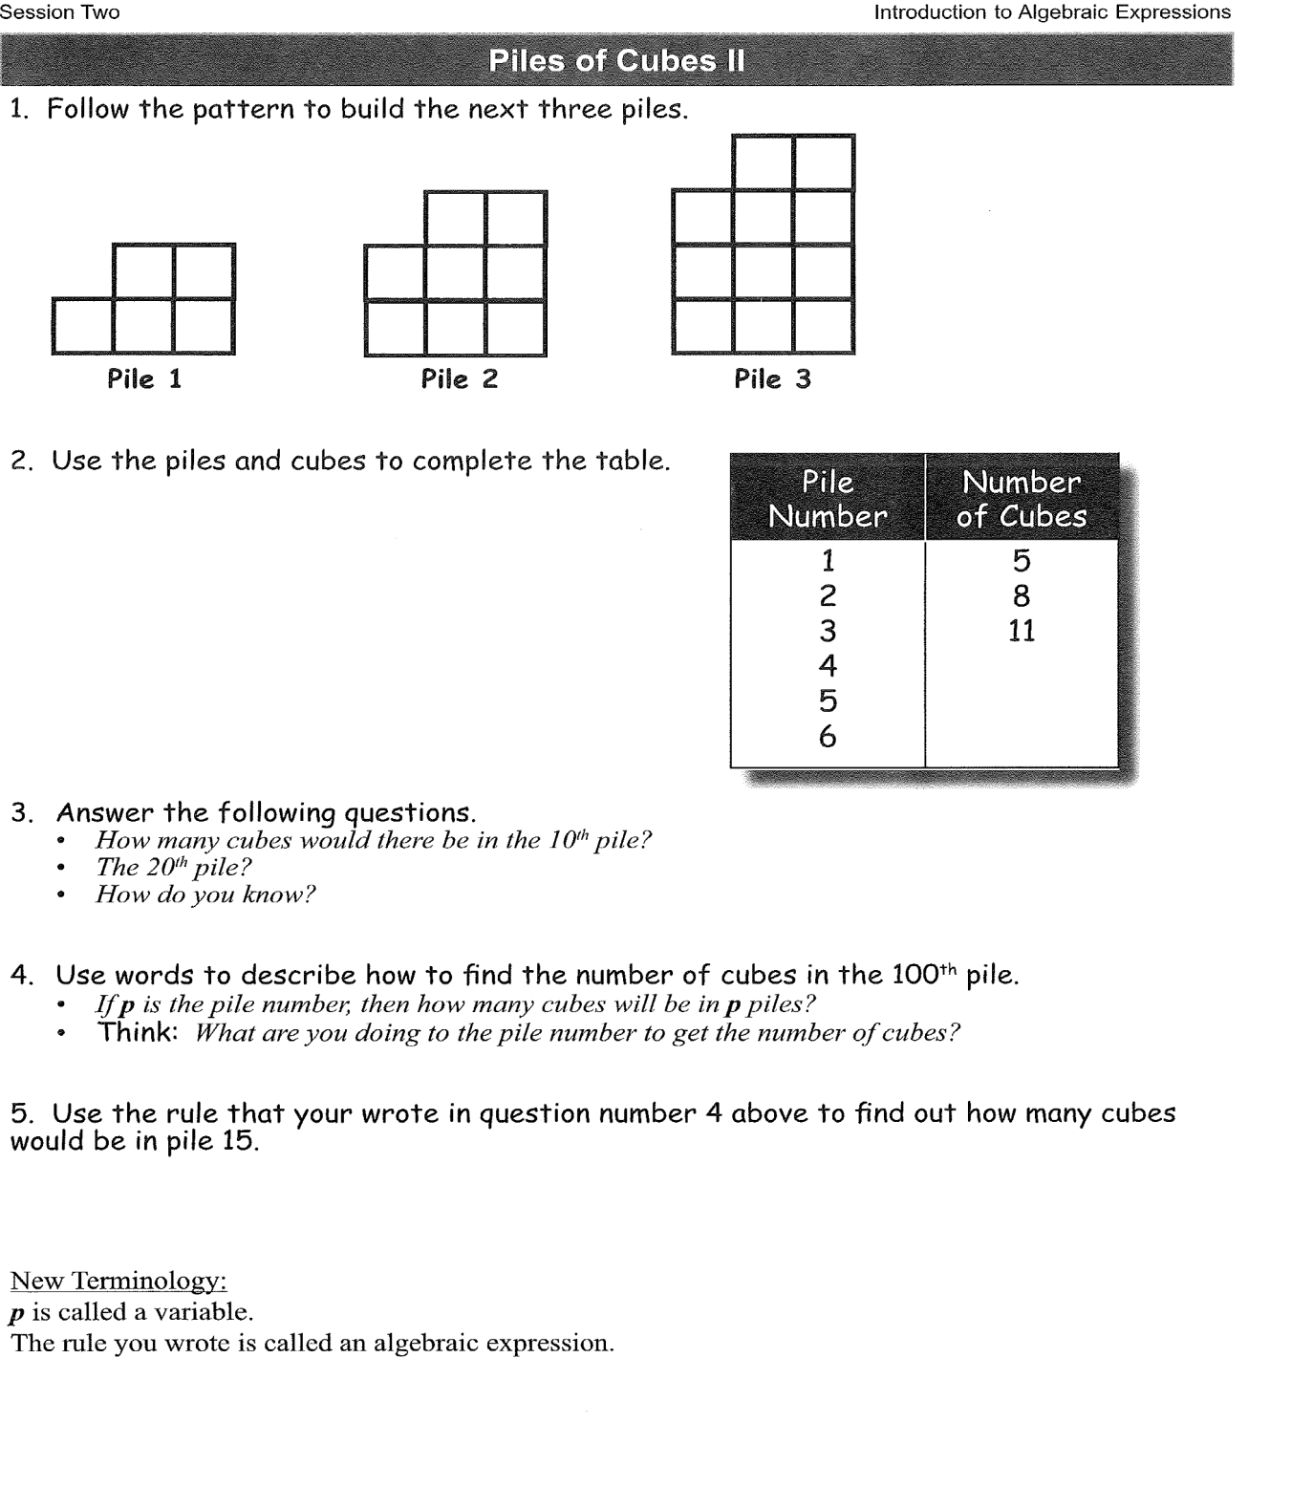

Slide 9
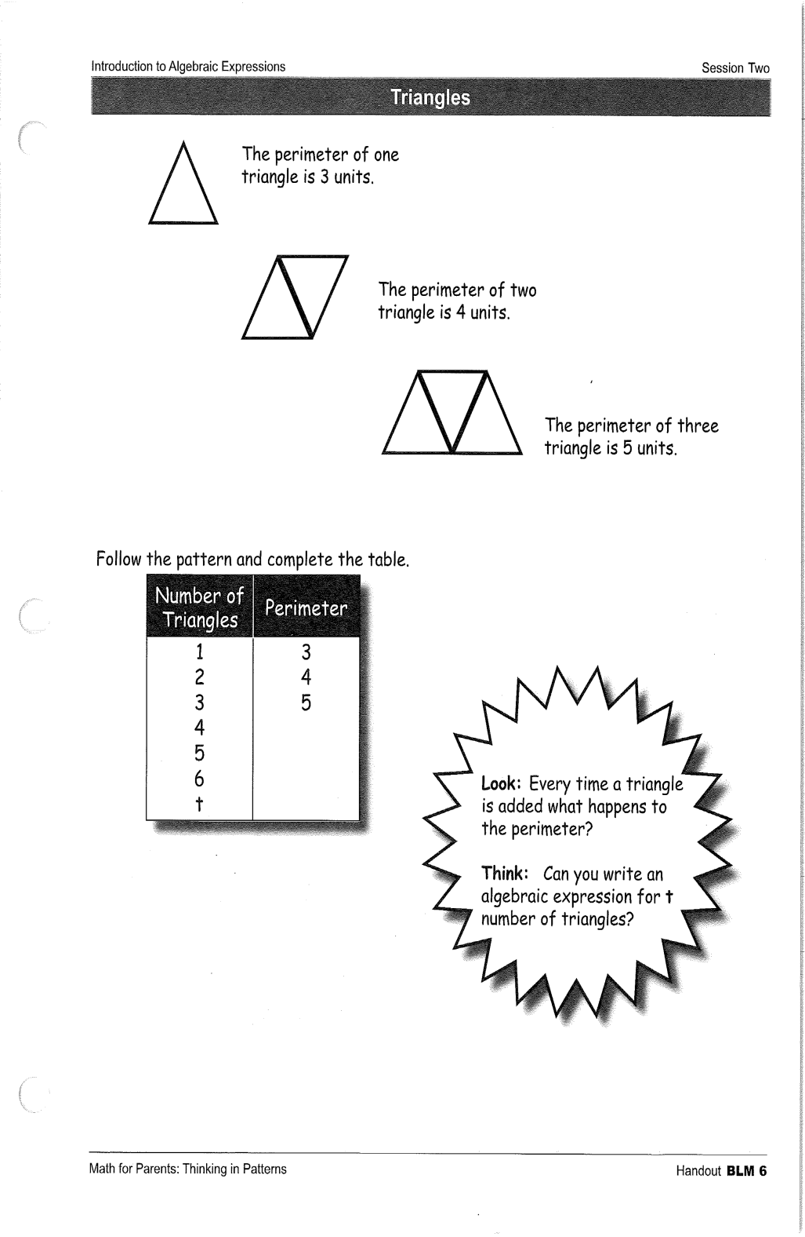
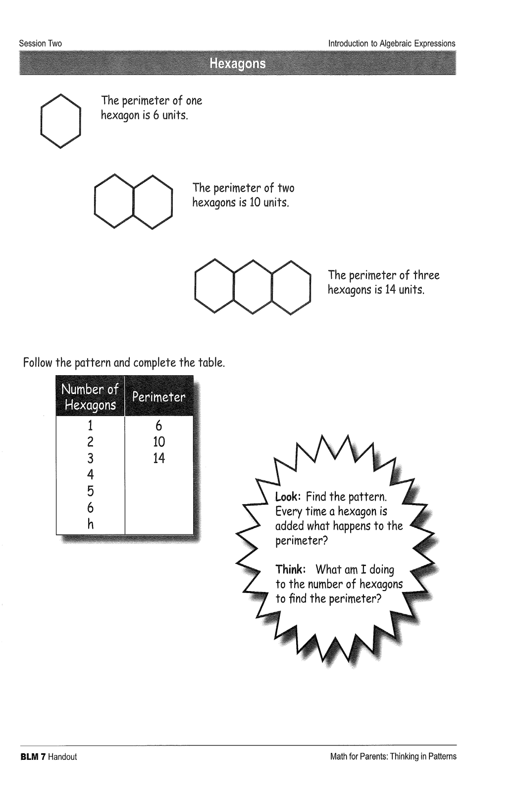

Slide 10
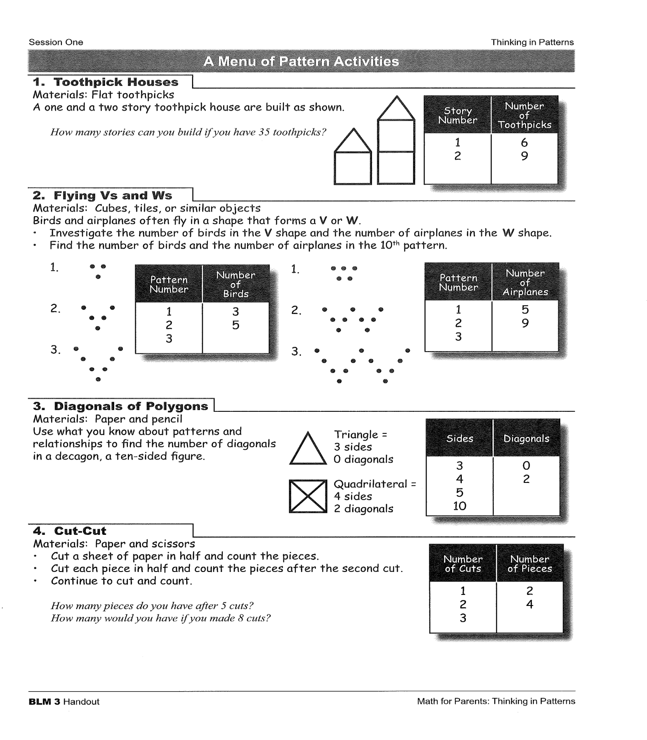

Slide 11

reflections
What were your steps to find an expression?

Slide 12
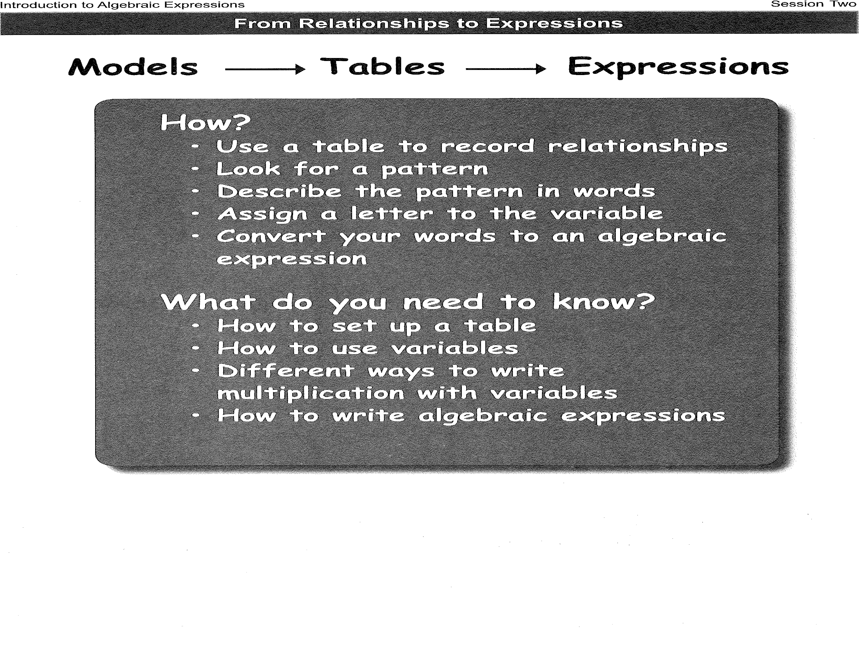

Slide 13

Homework
Try another one!

Slide 14
Thank you so much
See you all next week!

