Slide 1
Styles in Tiles
MAPPS
Developing Spatial Sense

Slide 2
Welcome!!!!
Using the tiles at your table, create various designs.
Agenda
-Review previous lesson
- Patterns
- Styles in Tiles Problem

Slide 3
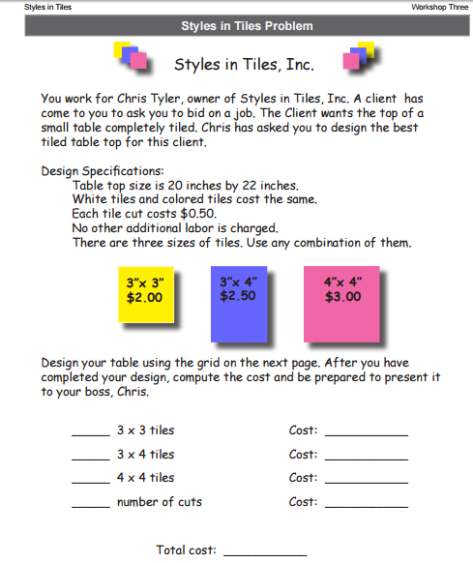
Design a Tabletop – BLM 26
The dimensions of the table (20 x 22)
The three sizes of tiles
The cost of each size
Each cut costs 0.50
Calculate your costs

Slide 4
Sharing Our Designs
What qualities make up the best designs?
What mathematics did you do in this problem?

Slide 5
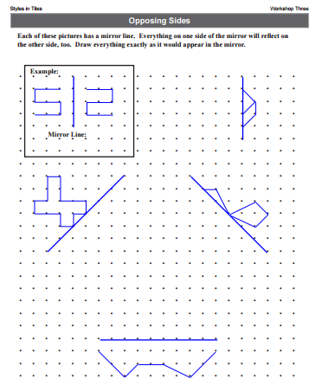
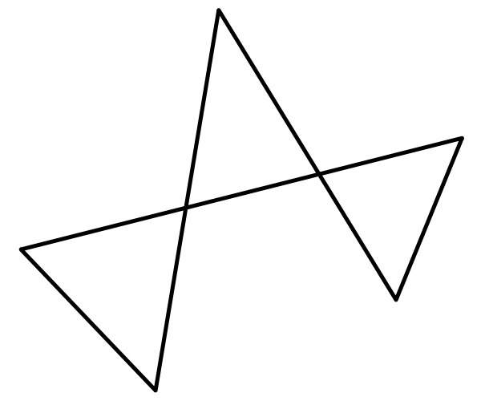
Opposing Sides – BLM 35
Can you construct the opposing figure?

Slide 6
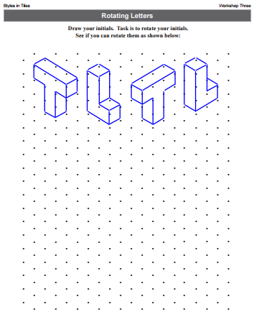
Rotating Letters – BLM 37
Draw your initials.
See if you can rotate your initials!

