Slide 1
Session seven

Slide 2
Let’s recap!

Slide 3
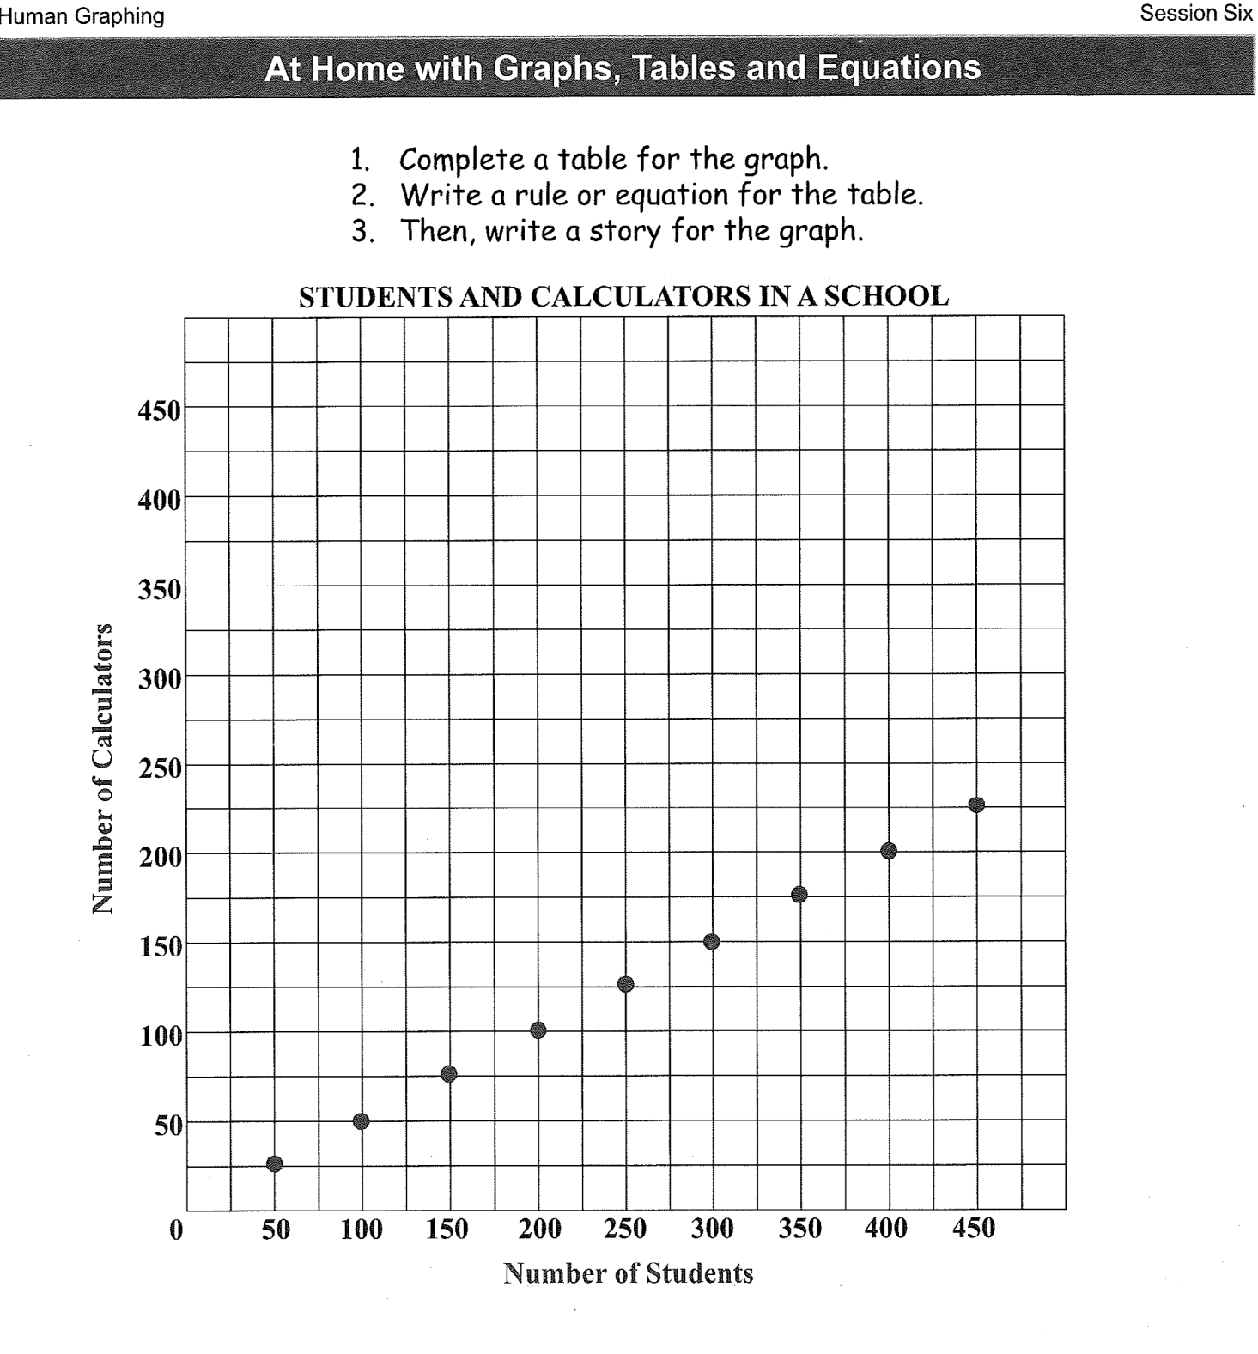

Slide 4
What are some important words we learned in the last session?

Slide 5
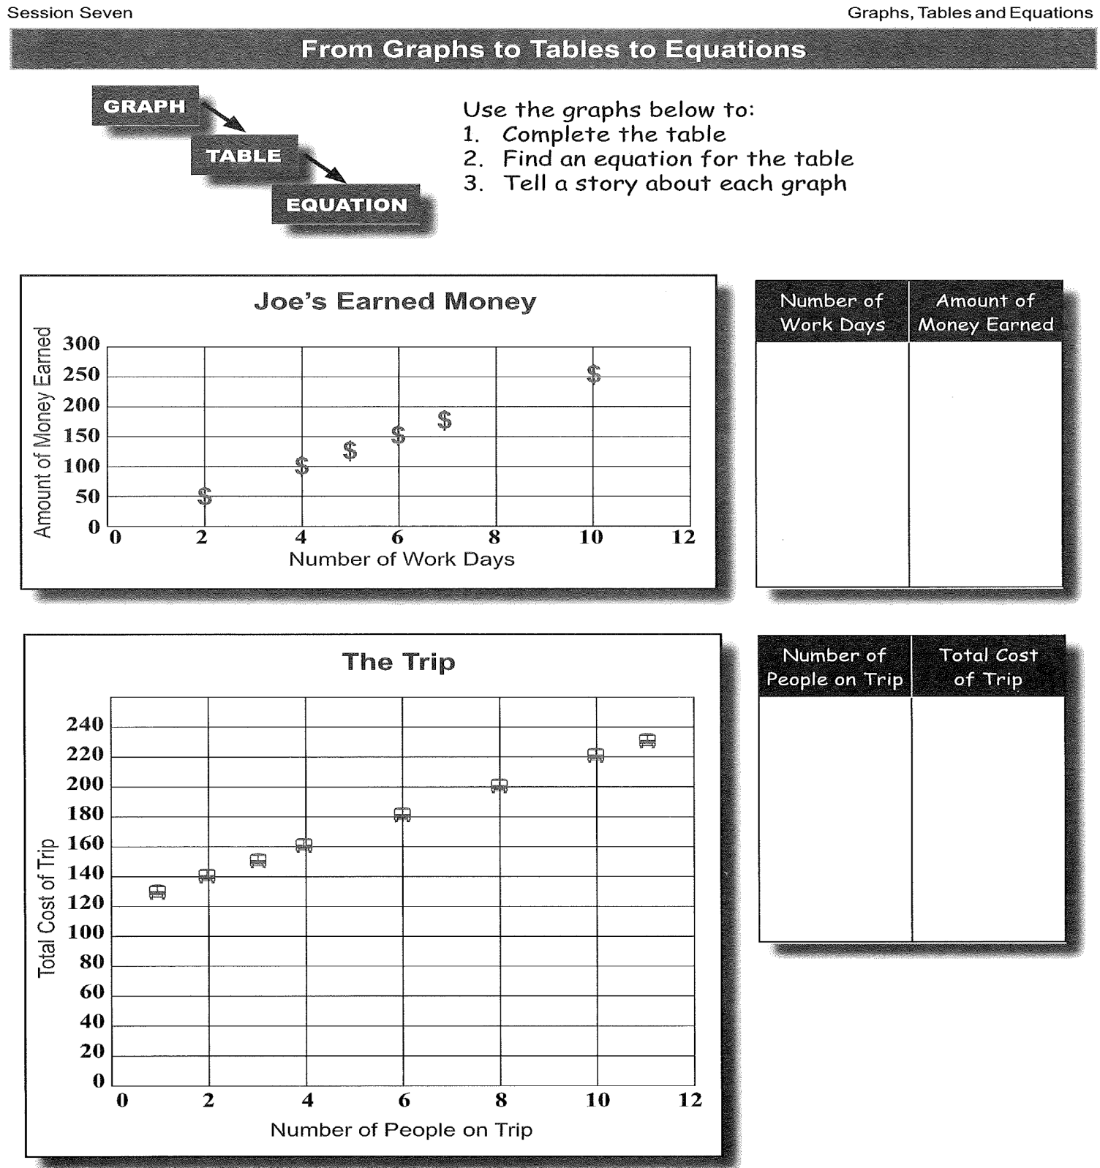

Slide 6
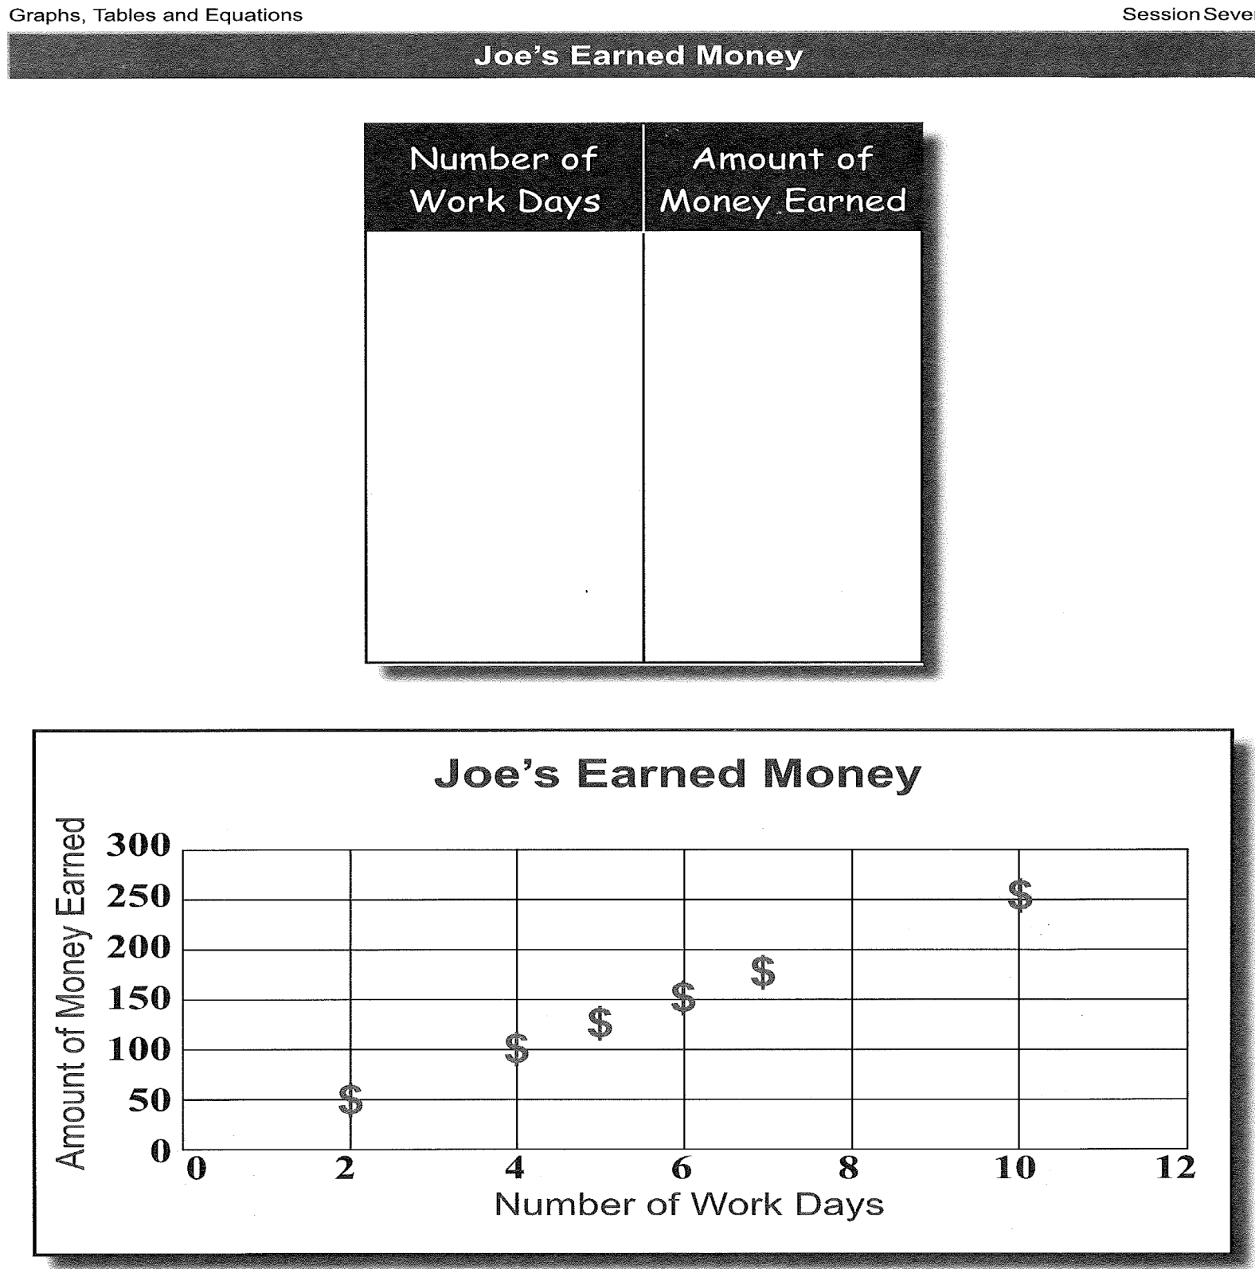

Slide 7
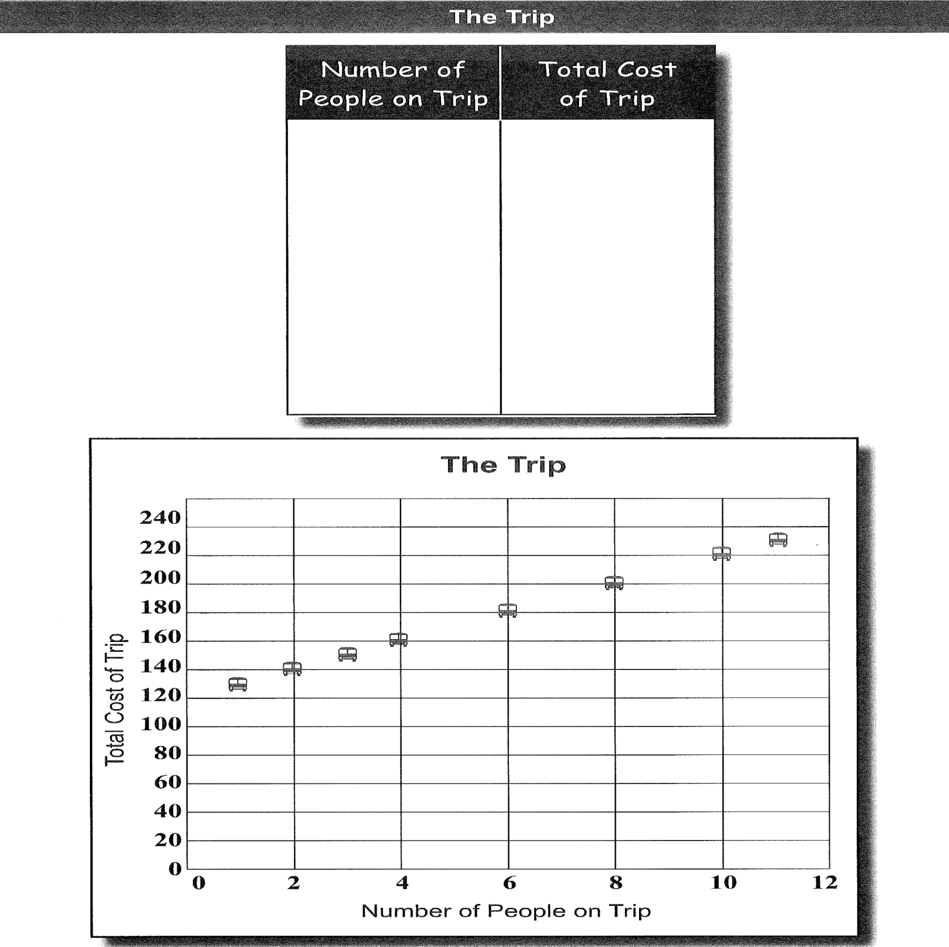

Slide 8
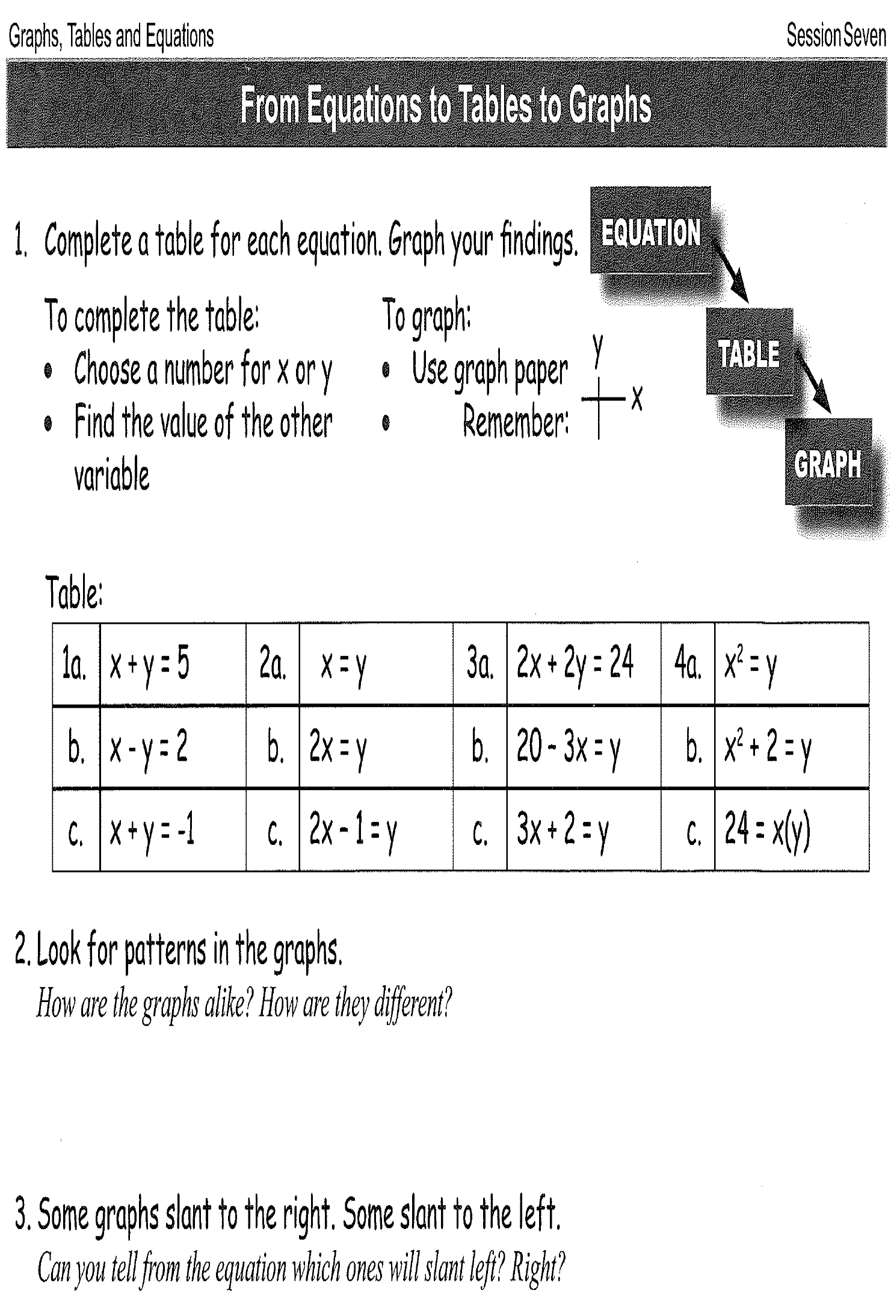

Slide 9
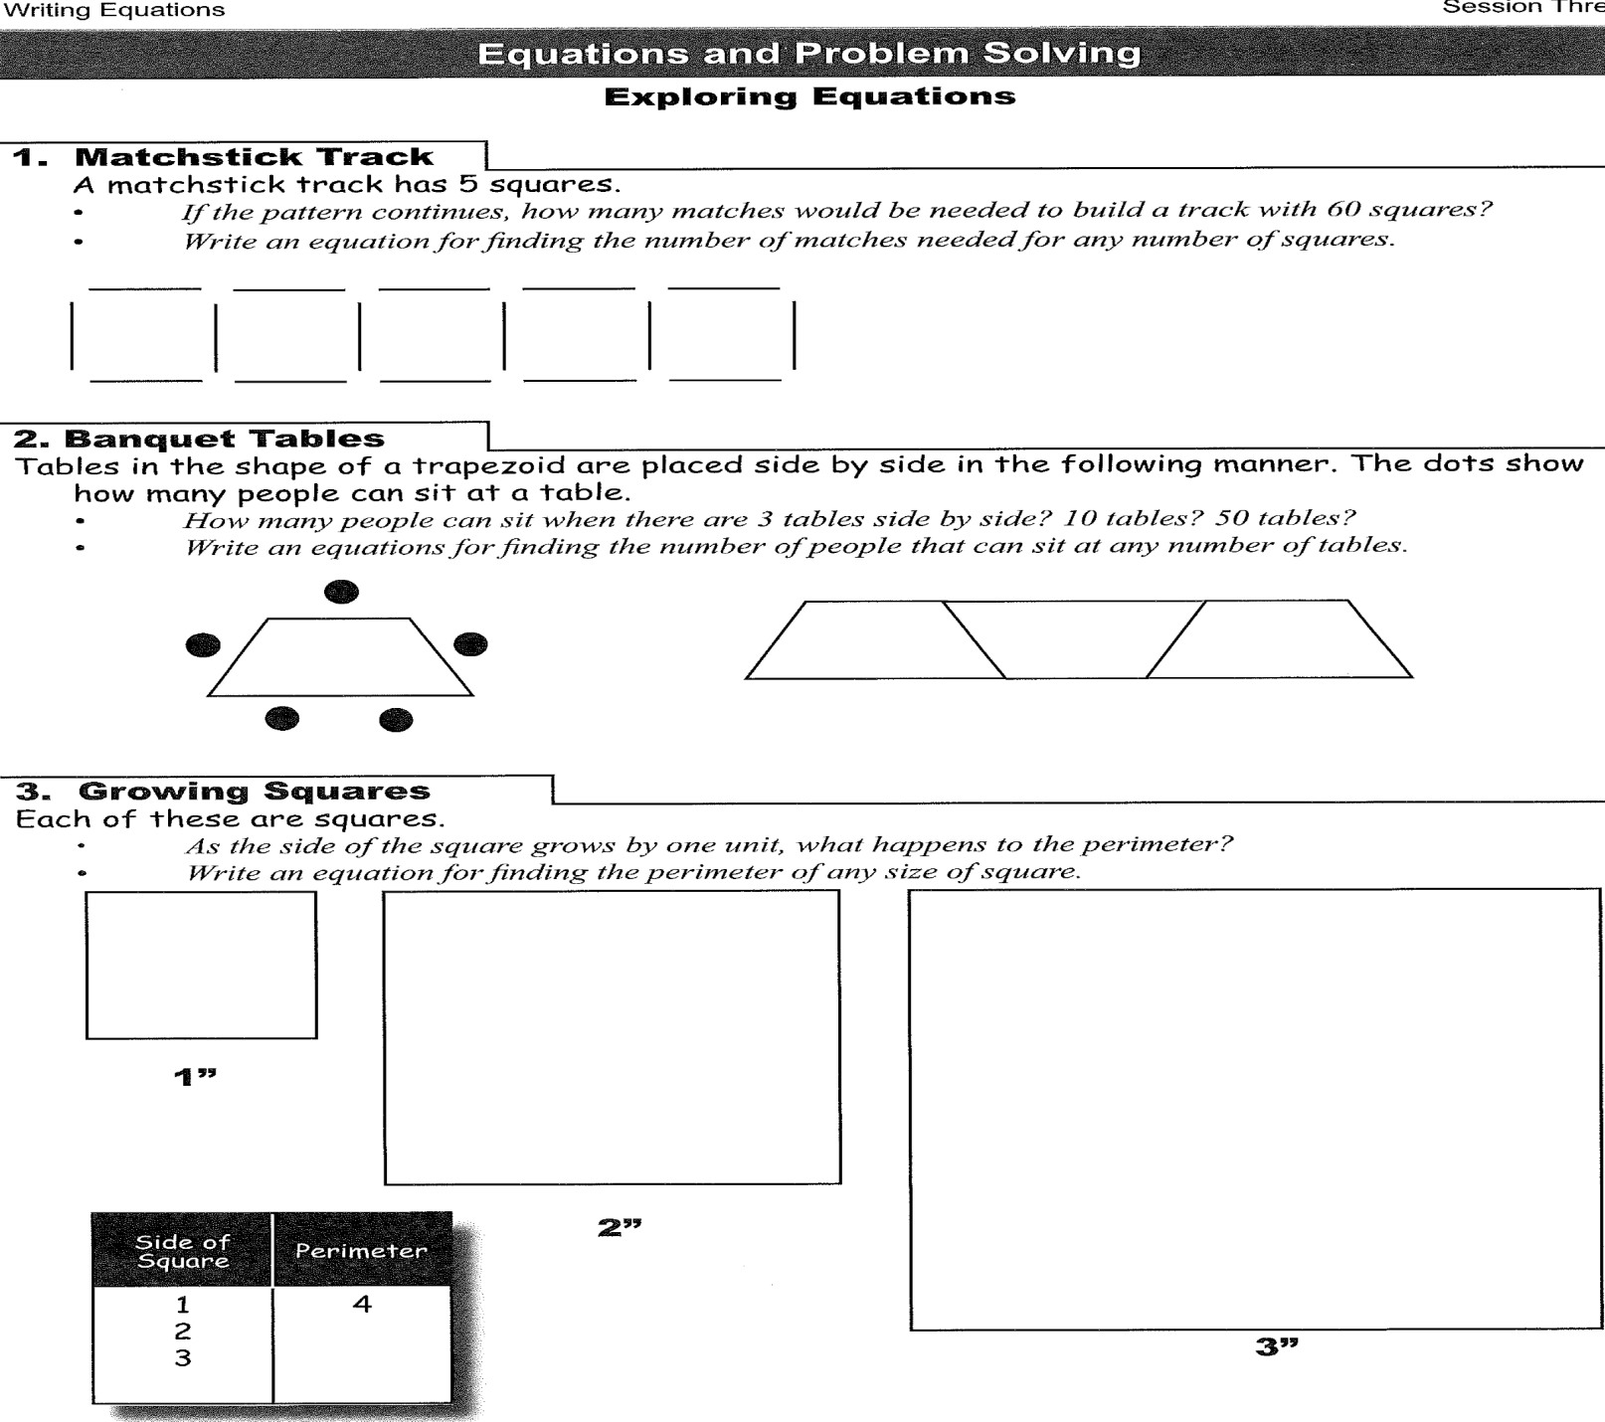
homework

Slide 10
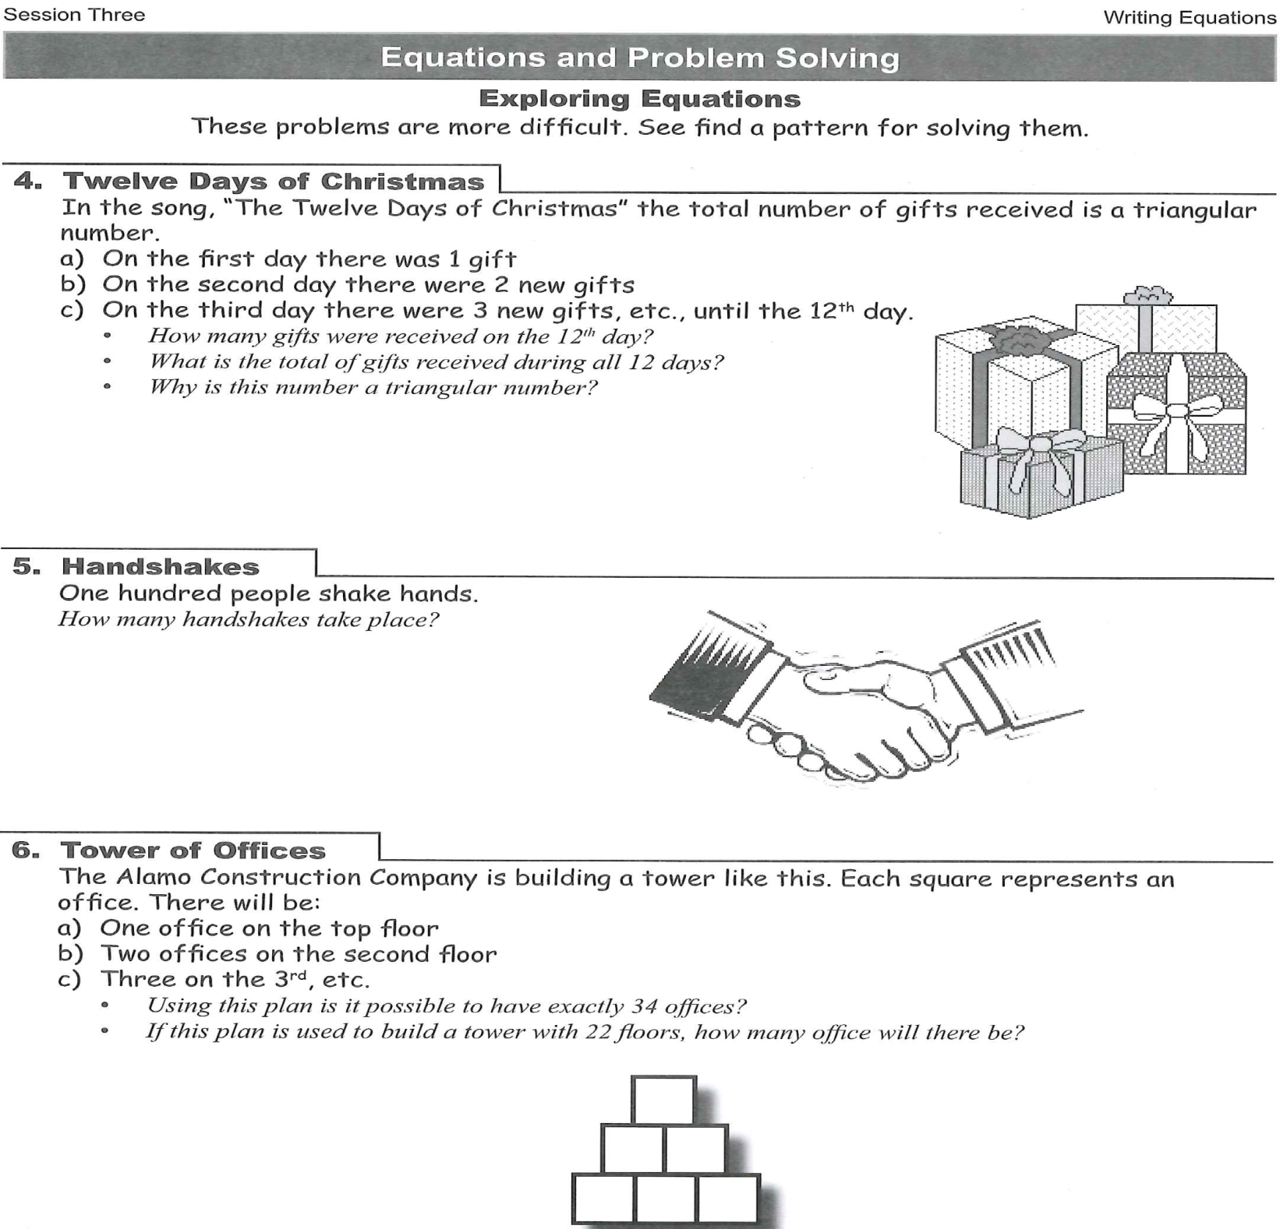

Slide 11
Thank you so much
See you all next week!

